Slide 1



A Glance Back, and a Hard
Look Forward
‘
October 2015

Slide 2
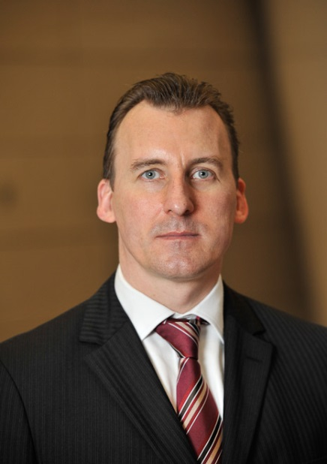

Geert Aalbers Senior Managing Director & Head of Brazil São Paulo
Marcos Casarin Senior Economist Brazil London
2

Slide 3
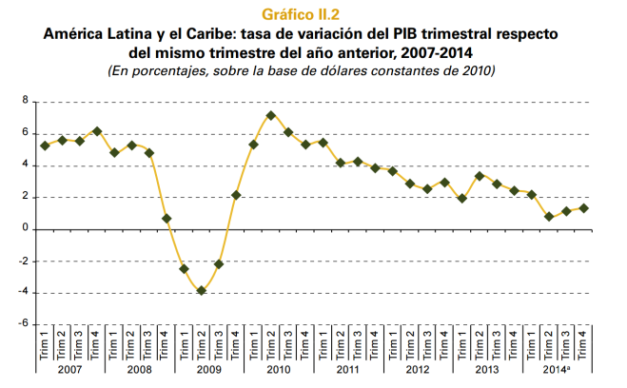
Region is facing external headwinds
End of commodities super cycle
The China factor (instability, demand)
Middle-income “trap”
And also internal vulnerabilities
Low productivity and large informal economy
Lack of investment, infrastructure
Weak governance and rule of law

Slide 4

And Brazil...changes ahead?

Slide 5

Lula (2003-2010)
External tailwinds
(commodities, China)
Macroeconomic “tripod”
(primary surplus, inflation targeting, floating FX)
Social programs; active (and leftist) foreign policy
High approval rating + consensus-building skills = political stability
Rousseff (2011-)
Same party, different policies
Less favourable external scenario, lack of competitiveness
“New economic matrix”
Social programs expanded + state intervention (BNDES, Selic, gasoline, electricity)
Riffs with PMDB = defeats in Congress since 2012
Rousseff’s approval ratings nose-dive to single digits (9%); mass anti-government rallies

Slide 6
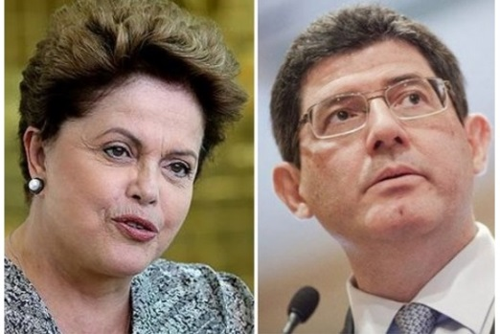
2015
The “perfect storm”?
Weak mandate and low approval ratings
An unruly ruling coalition
Petrobras scandal
Need to implement a unpopular austerity plan
Possible water and energy crisis
Loss of investment-grade status

Slide 7

Gavin commentary on Car wash
Car Wash investigation: What next?
Reach of investigation?
Reach of litigation: international, class action?
Limits of institutional stress?
Regional contagion?

Slide 8
Gavin commentary on Car wash
Car Wash investigation: What does this mean for you?
Designing a New Brazil Playbook
Corruption risk has increased: H x H
Risk Assessment: deepen the exercise
Tailor training: behaviours, not laws
Third parties: deepen pre-transaction scrutiny and DD
Monitoring and audit rights: use them, and lower the threshold
Whistleblowing lines: never a better moment

Slide 9
Impeachment?
Court of Audits (TCU)
The TCU recommends government accounts for 2014 be rejected; the Rousseff administration is being accused of “fiscal maneuvering”
Supreme Electoral Court (STE)
Opposition PSDB claims that Rousseff received illegal funds during the 2014 presidential campaign
Petrobras scandal
Allegations could emerge, specifically implicating Rousseff
Must relate to offenses made since January 1, 2015

Slide 10
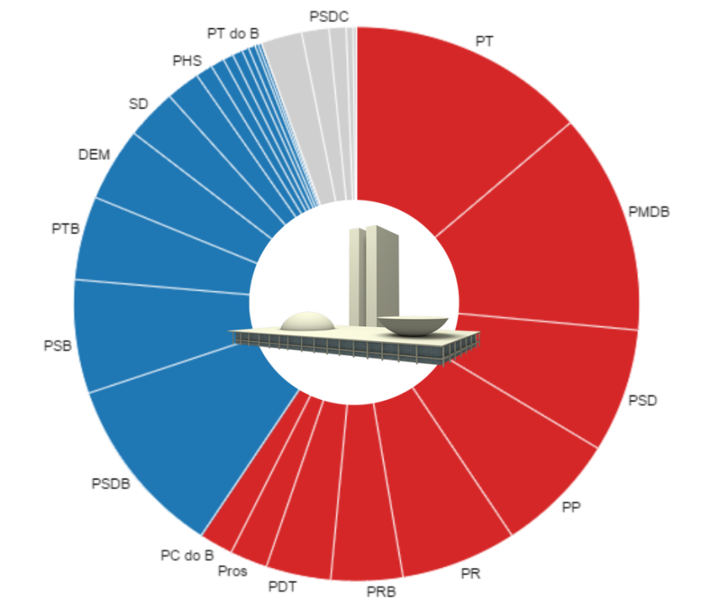
A shrinking coalition
PT + PMDB
Two largest parties in Congress
A marriage of convenience during much of PT’s term in power (since 2003)
PMDB has traditionally focused more on power than ideology
Relationship turned sour under (because of?) Rousseff, particularly since 2012
PMDB currently split between supporters and opponents of Rousseff
Key stakeholders
Michel Temer (VP)
Eduardo Cunha (speaker of Chamber of Deputies)
Renan Calheiros (speaker of Senate)

Slide 11
The “new normal” in Brazil
Politics
- Opposition to Rousseff will remain fierce, in Congress and in the streets
- Political uncertainty to persist
- Silver lining: Rousseff has never been more market-friendly!
Corruption
- Petrobras scandal will continue to broaden; reputational risks
- Silver lining: part of a wider improvement, business practices are changing
Economy
- Recession in 2015, poor 2016
- Silver lining: change in economic policy is real, the government is truly concerned about rebalancing public finances

Slide 12
Where are the opportunities?
Installed capacity for solar to increase from to 35 MW to 3.5GW by 2023; positive precedent from wind power
Consumer goods
Health and education
Renewables (wind, solar)
Petrobras assets
Construction and infrastructure
Agriculture
Local firms enduring a credit crunch and in need of cash
Several mid-sized companies, lack of dominant players; low penetration for certain sub-sectors
Middle class under strain, but still sizeable
Brazil is a powerhouse
Divestment plan worth USD 15bn - 30% E&P, 30% downstream and 40% gas & power

Slide 13


Economic outlook for Brazil:
No pain, no gain
Marcos Casarin│Senior Economist
mcasarin@oxfordeconomics.com
October 2015

Slide 14

Oxford Economics
Oxford Economics is one of the world’s foremost independent providers of global economic research and consulting
Founded in 1981 as a joint venture with Templeton College in Oxford University
Team of more than 150 in-house economists
Forecasts for 200 countries, 100 industries and 3,000 locations globally
Unique Global Economic Models
Detailed scenario capability
Links to Oxford University and other leading research institutes

Slide 15
Agenda
A glance back…
How did we end up here?
Why now?
…and a hard look forward
Is there a way out?
The adjustment scenario: no pain, no gain

Slide 16
A glance back…
How did we end up here?

Slide 17
How did we end up here?
It’s impossible understand ‘where we are now’ without going back and looking closely to what happened to:
Labour market
Credit and leverage
Supply and demand balance
Fiscal policy

Slide 18
Labour market: more is better, isn’t it?

Slide 19
But what about productivity?

Slide 20
No wonder Brazil lost market share in world trade!

Slide 21
Credit and leverage: the only way is up!

Slide 22
But there’s no free lunch: leverage also went up!

Slide 23
What about the supply side?

Slide 24
What about the supply side? Well, not so great…

Slide 25
And what happens when demand outpaces supply?

Slide 26
Fiscal policy: spending like there’s no tomorrow!

Slide 27
Where do we end up? With a collection of imbalances

Slide 28
A glance back…
Why now?

Slide 29
Why now?
We just saw that Brazil has been accumulating macro imbalances for quite some time…
…but why are we in crisis only now?

Slide 30
Because we no longer have the two sources of easy growth
1. Commodity super-cycle (2003-11)
2. Cheap money for EMs (2011-14)

Slide 31
Why is it important?
Growth model would have imploded sooner?
Less portfolio inflows (and BRL appreciation)?

Slide 32
A hard look forward…
Is there a way out?

Slide 33
Is there a way out?
Brazil entered 2015 full of macro imbalances as policymakers didn’t do their homework in the ‘bonanza’ years…
…now the country needs to prepare for a ‘new normal’ of:
China slowing (implying lower for longer commodity prices)
Stronger US$ and higher borrowing costs in hard currency
More selectivity from investors towards EMs

Slide 34
Who will benefit from this environment?
Countries with:
Limited exposure to the Chinese slowdown
Fewer domestic headwinds (strong domestic demand)
Good fundamentals (those who did their homework)
Benefit from lower oil & commodity prices
Can Brazil still thrive in such a challenging environment?

Slide 35
A hard look forward…
No pain, no gain

Slide 36
Yes, but policies need to be adjusted…
Our baseline scenario is one of a political and economic muddle-through…
Political uncertainty, volatility, but no impeachment
Very limited progress in structural reforms

Slide 37
As a result, growth will remain moderate…

Slide 38
…and debt will be unsustainable in the long-term

Slide 39
Alternative is to adjust policies and push through reforms
Using our macro model, we ran an adjustment scenario.
Key assumptions include:
Restoring primary surpluses through tax hikes & spending cuts
Limiting growth of gov’t spending to that of GDP
Progress on productivity-enhancing reforms

Slide 40
First things first: put public finances back in order

Slide 41
No pain, no gain

Slide 42
Bottom line
Where we are today is a result of imbalances accumulated in the past
From now on, it will be the survival of the fittest – and Brazil needs to work out more!
First things first: put the public finances back in order to build a bridge for growth-enhancing reforms once the storm is over
No pain, no gain: any positive results from the macro adjustment will only show up after 3-4 years
Hence, we see the adjustment as an unlikely scenario – politicians have no incentives to pursue adjustment now.

Slide 43
Perguntas?
geert.aalbers@controlrisks.com
mcasarin@oxfordeconomics.com

