Slide 1





Introduction to the Paris Climate Bond concept
Brazil’s Green Bonds Markets: Structures and Perspectives, Thursday 27 September 2018
Email: daniel.rossetto@climatemundial.com
Website: www.climatemundial.com

Slide 2

Disclaimer
This presentation has been prepared for discussion purposes only and is not an offer to sell or a solicitation to buy any financial product, nor to provide financial services or financial advice. While this presentation may make reference to various financial products no such reference should be taken to be an endorsement of such products by the Authors. The Authors have attempted to provide accurate and complete information obtained from reliable sources, however, the Authors make no warranties or representations, express or implied, as to whether information provided in this presentation is accurate, complete or up-to-date. The reader should therefore be fully aware of these limitations and, where further accuracy is required the reader should seek its own professional advice. Unless otherwise prohibited by law, the Authors disclaim all liability for any loss or damage suffered by any person using, disclosing, relying or acting on any information supplied to it or inferred from information supplied by the Authors or any of their representatives. The Authors retain all present and future rights (including copyrights, trademarks, patents as well as any other intellectual property right) in relation to its own work within this presentation. You may not copy, download, publish, distribute or reproduce any of the information contained in this presentation in any form without the prior written consent of the Authors. The Authors make no representation and gives no advice in respect of any financial, investment, tax, legal or accounting matters in any jurisdiction including the suitability of financial products to investors. The Authors shall not, nor any of its agents or subcontractors, be liable for any direct, indirect, special, incidental, consequential, punitive, or exemplary damages, including lost profits (even if the Authors are advised of the possibility thereof) arising in any way from, including but not limited to: (i) the information provided in this presentation; (ii) the modification or misuse of information in this presentation; or (iii) claims of third parties in connection with the use of this presentation. This exclusion of liability is made for the benefit of directors and employees of the Authors. This presentation has been prepared without taking account of the reader’s objectives, financial situation or needs. Consequently, before acting on the information in this presentation, the reader should consider the appropriateness of the information in view of its own objectives, financial situation and needs.
Climate Mundial Ltd is a Private Limited Company registered under the Companies Act 2006 in England & Wales. Company number: 8073353. Climate Mundial is authorised and regulated by the Financial Conduct Authority (UK).
Commercial in Confidence

Slide 3
Brazil’s Nationally Determined Contribution (NDC)
Key 2030 Targets in the NDC:
Increase the share of sustainable biofuels to 18% of national market.
Achieve zero illegal deforestation.
Restore and reforest 12 million Ha of forests.
Achieve 28-33% penetration of non-hydro renewables in the total energy mix.
Restoration of 15 million Ha of degraded pasturelands.
Restoration of 5 million Ha of integrated cropland-livestock-forest systems.
Commercial in Confidence

Slide 4
Paris Climate Bond (PCB) Concept
PCB is a financing concept that provides cost-effective, long-term debt funding for projects and programs in emerging markets that are registered with current and future mechanisms of the UNFCCC.
PCB raises funding primarily from the private sector. It also deploys climate finance available from public sources and aggregation concepts to optimize the risk and return profile of the finance mobilized.
PCB is focused on creating and popularizing an asset class that provides international debt capital markets a liquid instrument through which to invest in low carbon infrastructure in emerging markets.
In order to benefit from PCB financing, a core criterion for participation is that projects and programs be registered with current and future mechanisms of the UNFCCC (such as the CDM).
PCB introduces a contractual mechanism by which the ex-ante volumetric mitigation outcome estimates, including CER delivery, are enforced.
UNFCCC-registration and contractual enforcement provisions afford certainty to investors that projects are delivering climate and sustainable development benefits that are real, verified and additional to business as usual, determined in accordance with multilateral standards.
The above features render PCB a much needed innovation in the area of climate-themed bonds and in the allocation of climate finance.
Commercial in Confidence

Slide 5
PCB and the UNFCCC Process
Procedural background to the PCB Concept
COP21 Paris, 2015 & CMP11, Paris, 2015
Decision 6/CMP 11 – “Encourage the Executive Board to continue exploring options for using the clean development mechanism as a tool for other uses and report back to the Conference of the Parties serving as the meeting of the Parties to the Kyoto Protocol at its twelfth session.’
SB44 Bonn, 2016 & EB-91 Bonn, 2016
Workshop held at SB-44 in Bonn at which Paris Climate Bond concept, developed by Climate Mundial and Baker & McKenzie, was presented to delegates. PCB included in the concept note presented to EB-91 for formal support and included in report back to CMP12.
COP22 Marrakech, 2016 & CMP12, Marrakech, 2016
Decision 4/CMP 12 – Based on the outcomes of SB-44 and EB-91, CMP12 agreed to ask the Executive Board “to continue its activities in response to decision 6/CMP.11, paragraphs 7 and 8”.
Commercial in Confidence

Slide 6
Paris Climate Bond Project
PCB Project is designed as demonstration of the PCB concept including the following two important stages of work:
  Project Finance: making loans to eligible projects – that is, projects and programs registered with current and future mechanisms of the UNFCCC – in developing countries.
  Refinancing: establishment of a new entity to purchases PCB loans, the funding for which is raised via the issuance of PCB commercial notes.
Together with our implementation partners we are designing PCB such that it may be possible in future to list both the Investment Vehicle(s) and PCB commercial notes on one or more exchange(s), leading to increased liquidity.
Following first issuance of PCB commercial notes, a Best Practice Guide shall be published to generate additional interest and drive scaling-up.
Commercial in Confidence

Slide 7
UNDP & Climate Mundial
Framework partnership to support developing countries efforts to raise finance for NDCs
Area 1 – Investment Portfolio Development Linked to National NDCs
Development and maintenance of a portfolio and pipeline of investment opportunities that originate from the policies and programs nominated under the NDCs of developing countries.
Area II – Cooperative Approaches, Arrangement of Finance and De-risking
Working with developing countries to ensure the arrangement of finance to implement the portfolio and pipeline of investment opportunities mentioned in (i) above, which may include the commercialisation of internationally transferrable mitigation outcomes issued pursuant to Article 6 of the Paris Agreement.
Area III – Capacity Building and Training
Capacity building and training in the areas of business, investment and finance relating to sustainable development.
Commercial in Confidence

Slide 8
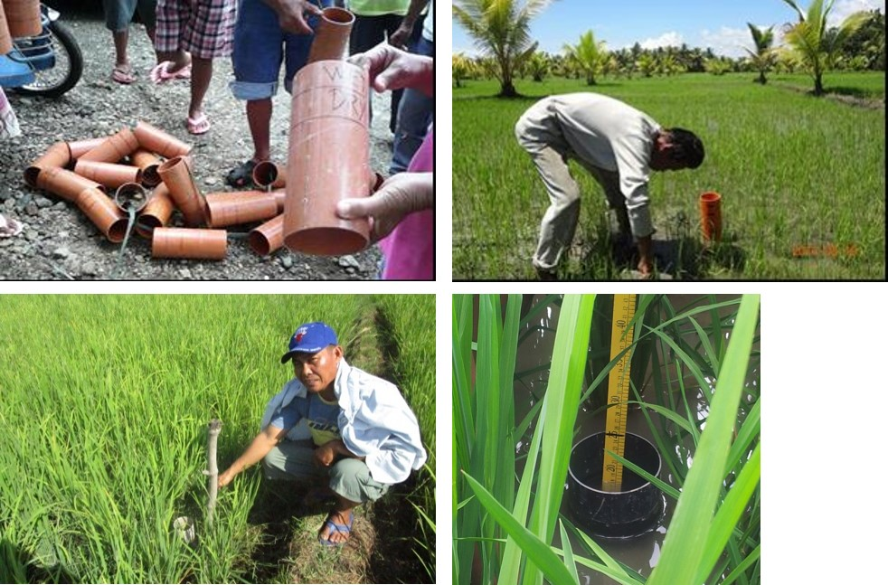
Examples of Green Field PCB Application
Methane reduction in rice cultivation in the Philippines
Engaged with the Philippines Government (led by the Philippines Rice Research Institute) and UNDP to implement a nationwide sectoral program that provides financial incentives for small-scale farmers and irrigation associations to adopt Alternate Wetting and Drying (AWD) techniques instead of continuous flooding.
Measurement and verification utilises a CDM standardised baseline.
Financial incentives provided to farmers take the form of direct payments for emission reductions (in USD) and the provision of microfinance through local financial institutions.
Cost and tenor of finance is supported via application of PCB. Program is currently in its detailed preparation phase following completion of AWD piloting.
Commercial in Confidence

Slide 9
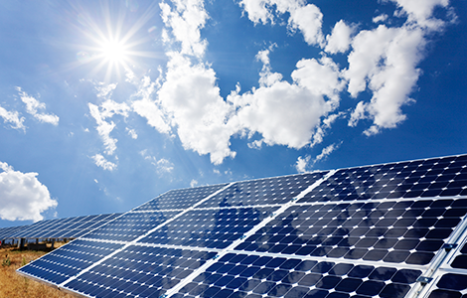
Examples of Green Field PCB Application
Grid-connected solar photovoltaic power generation in The Gambia
Engaged with the Government of The Gambia (led by the Ministry of Environment) and UNDP to implement a sector program that will deliver up to 15MW of distributed solar photovoltaic power generation connected to national and regional electricity grids over the next five years.
All projects participating in the program shall be financed utilising PCB.
The program will be registered as a Program of Activities under the CDM and CERs will be cancelled as a contractual requirement using the UNFCCC platform for voluntary cancellation.
The program was included in the UNFCCC secretariat’s report at the 99th meeting of the CDM Executive Board and is currently in its detailed preparation phase.
Commercial in Confidence

Slide 10
Summary of Key Points
Providing long-term financing to support NDC implementation in developing countries
Broad Applicability with Private Sector Engagement
PCB offers opportunities to both public and private sector projects, across the full spectrum of sectoral scopes and in all countries able to participate in UNFCCC mechanisms, subject to confirmation through robust regulatory due diligence, to raise funding at scale.
Benefits to Developing Countries
Financial benefits to projects and programs are delivered through a real funding cost advantage, which can be used to capitalise the value of the mitigation benefits to be delivered, with access to international capital markets and additional sources of finance.
Transparency on Mitigation Outcomes
Public and private investors gain certainty over the quantity and environmental integrity of mitigation outcomes to be delivered, as well as a method to track title (via serial numbers) on transfers of units. Host countries accelerate implementation of NDC.
Commercial in Confidence

Slide 11
Introduction to the Paris Climate Bond concept
Brazil’s Green Bonds Markets: Structures and Perspectives, Thursday 27 September 2018
Email: daniel.rossetto@climatemundial.com
Website: www.climatemundial.com

