Slide 1
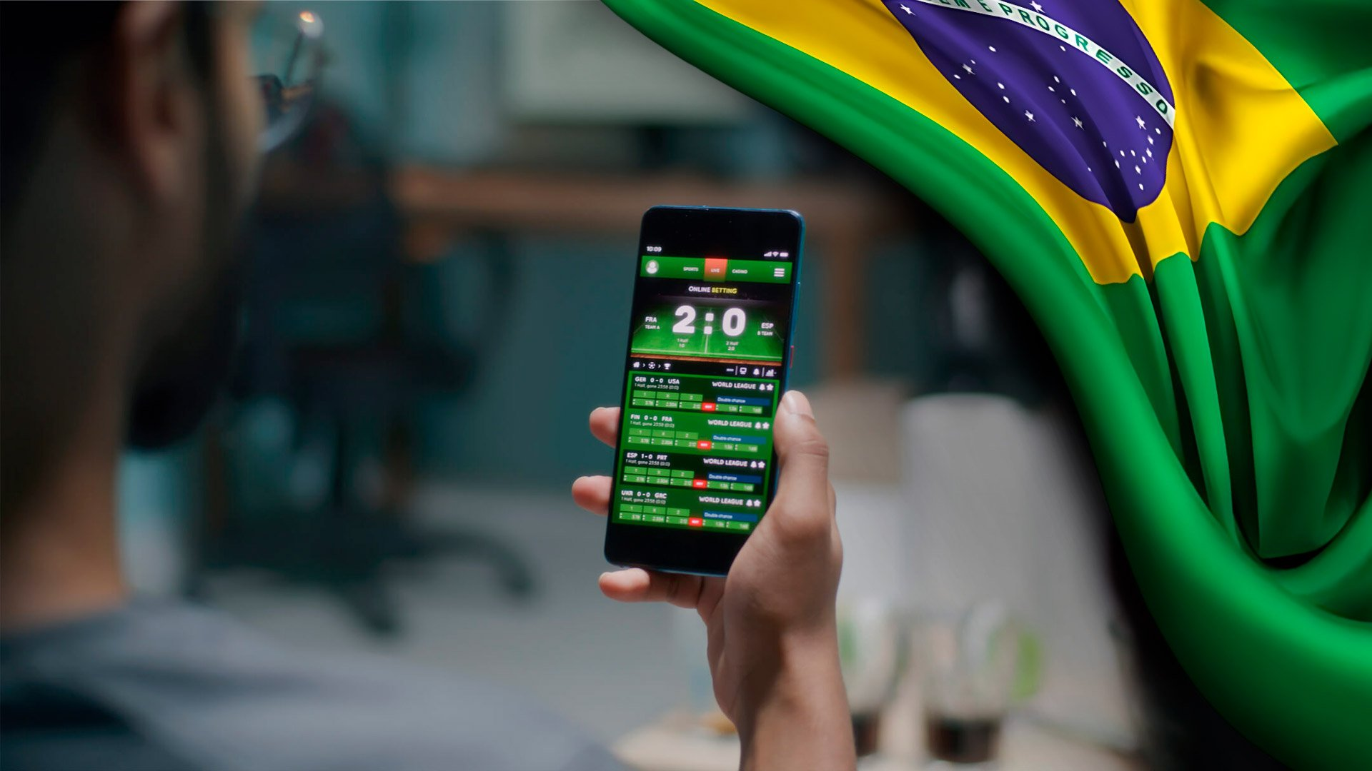

E-GAMING AND SPORTS BETTING IN BRAZIL
MARKET OVERVIEW
Event: Brazilian Chamber of Commerce Great Briatin
MAY 2024

Slide 2
RedirectIon International

Slide 3
Redirection international
Strategic Management
Corporate
Finance
Value Generation
Valuation
Mergers & Acquisitions

Slide 4
REDIRECTION STRATEGIC SECTORS
$
BUSINESS
SERVICES
CONSUMER
& RETAIL
ENERGY, CLEANTECH
& RESOURCES
FINANCIAL
INSTITUTIONS
HEALTHCARE & LIFE SCIENCES
INDUSTRIALS
TECHNOLOGY,
MEDIA & TELECOM
Business process outsourcing
Education
Facility management
Staffing
Transport & logistics
Agribusiness
Clothing retail
E-commerce
Foodservice
Food & beverage producers
Luxury goods
Supermarkets
Metals & mining
Mining services
Renewable energy technology
Wind & solar
Asset management
Debt collection
Family offices
Financial services
Insurance
Private equity
Animal health
Dental
Hospitals, clinics,
and residential care
Lab services & equipment
Medical devices
Medical supplies
Medtech
Pharma & biotech
Automotive
Building products
Chemicals
Industrial services
Machinery
Packaging
Accounting & enterprise software
Digital & traditional media & marketing
E-payment
Fintech
Gaming
HR software
IT services
IT consulting
Security software

Slide 5
BRAZIL: AT A GLANCE

Slide 6





BRAZIL: AT A GLANCE (1/2)
One of the world’s best investment destinations
BRAZIL
214.3mil
Population
3rd
Largest FDI destination
Federative Republic of Brazil
Socio-Economic
Investment
Largest consumer market in LATAM, retail sales of $~500M
Strategic geographic position that allows easy access to other LATAM countries
Qualified, cheap labour resources
Emerging economy with westernized legal system
$86B in global FDI, increase of 68% from 2021, behind just US and China
Cross-border M&A in Brazil hit R$121B in 2022, 25% of all deal flow
Fragmented industries in multiple sectors
Brasília
$2tr
Brazilian GDP
Sectors
Brazil is a world leader in agrobusiness, technology and renewable energy
Acute growth expected in these sectors and also financial services, logistics
Large scale infrastructure investment programs and PPP´s
Economic Activity
~60% of GDP
is concentrated in 6 states
9th largest global economy: 7.5% annual GDP growth forecast to 2025
Diversified economy less vulnerable to global crises

Slide 7
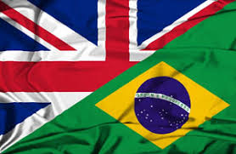




UK-Brazil TRADE FLOWS
Bilateral Trade, Investments and M&A Activity in Brazil
Top 5 COUNTRIES IN M&A IN BRAZIL (2023)
# CROSS-BORDER DEAL VOLUME & VALUE
Snapshot
Total trade in goods and services (exports plus imports) between the UK and Brazil was £10.4 billion in the four quarters to the end of Q3 2023, an increase of 28.2% or £2.3 billion in current prices from the four quarters to the end of Q3 2022. Of this £10.4 billion:
Total UK exports to Brazil amounted to £5.6 billion in the four quarters to the end of Q4 2023 (an increase of 36.1% or £1.5 billion in current prices, compared to the four quarters to the end of Q3 2022);
Total UK imports from Brazil amounted to £4.8 billion in the four quarters to the end of Q3 2023 (an increase of 20.0% or £800 million in current prices, compared to the four quarters to the end of Q3 2022).
In 2021, the outward stock of foreign direct investment (FDI) from the UK in Brazil was £10.8 billion accounting for 0.6% of the total UK outward FDI stock.
In 2021, the inward stock of foreign direct investment (FDI) in the UK from Brazil was £2.0 billion accounting for 0.1% of the total UK inward FDI stock.
BIDDER COUNTRY
No.
TOTAL VALUE (USDm)
United States
161
5,130
United Kingdom
53
1,401
Spain
23
585
Germany
18
1,663
Canada
22
703
Notes:
M&A geral, cros border, top paies, prvate equity... % cross
Global M&A Industry Trends: 2023 Outlook : PwC
https://capitalinvest-group.com/en/invest-in-brazil-ma-guide/
https://valor.globo.com/empresas/noticia/2023/01/05/fusoes-e-aquisicoes-caem-12percent-no-brasil-com-menor-apetite-por-tecnologia-em-2022-diz-kpmg.ghtml

Slide 8
SPORTS BETTING GLOBAL OUTLOOK

Slide 9






GLOBAL MARKET OUTLOOK
The global sports betting market showed the fastest growth in all commercial gaming segments, and is expected to grow by close to 10% over the next five years
GROWTH DRIVERS
Growth of digital infrastructure, Smart Phones and the prevalence of wireless connectivity
The online space is still only ~35% of the market but is forecast to be over 50% over the next few years, growing at ~15% over the forecast period.
Increasing investments in online platforms and use of Digital payments
The Internationalization of Global Sports
Growing Acceptance of Online Gambling & Betting
Changes in legislation, especially in emerging markets, as government´s seek to boost tax revenues
+9.2%
CAGR ‘23-30
VALUES IN USD bi
Source: Data Bridge Market Research

Slide 10
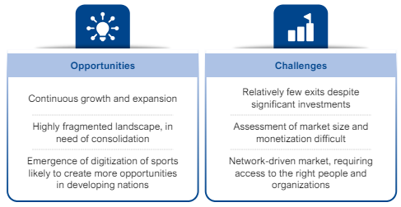
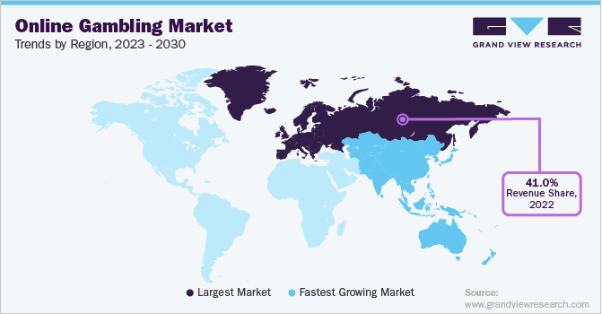
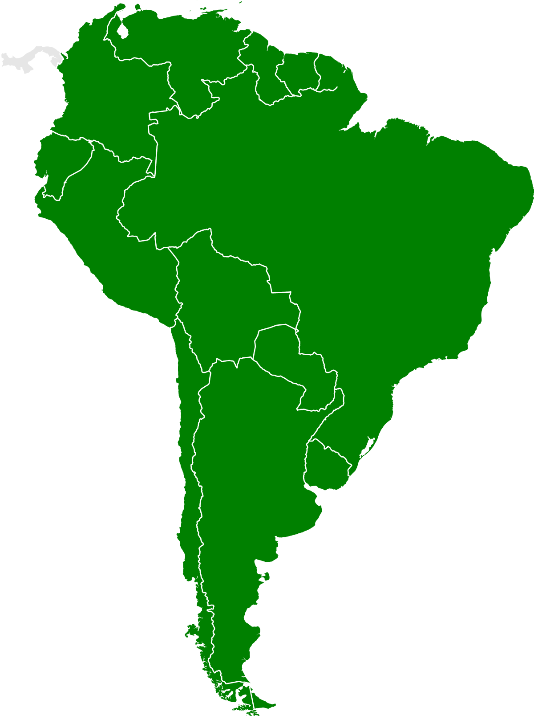
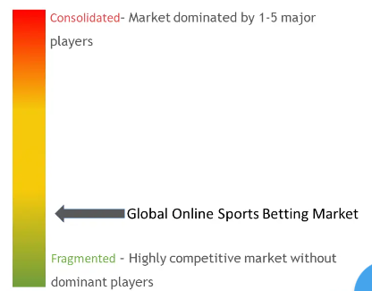

Global MARKET OUTLOOK
Global market still fragmented, Latam is one of the hottest growth spots
Global Online sports betting MARKET
Global Market competition online betting
~20%
Latam annual market growth
expected to 2028
Market
Drivers
Large population, Growing middle class with high smart phone usage but still low rates of online betting penetration
Traditional culture of betting
Popularity of sports and fandom
Improving regulatory landscapes
Source: Grand Viw Reserch,, Softswiss, Mordor Intelligence
Notes:
https://www.grandviewresearch.com/industry-analysis/online-gambling-market#:~:text=Other%20drivers%20for%20the%20market,European%20Gaming%20%26%20Betting%20Association%20study.
https://www.linkedin.com/pulse/betting-casinos-latin-america-exploding-market-renato-paulino-ea5vf/
https://www.softswiss.com/knowledge-base/latam-igaming/

Slide 11

Global MARKET OUTLOOK
Solid M&A activity: Competition amongst vendors is intensifying driven by the legalisation of sports betting across diverse jurisdictions, the digitization of gaming offerings, and the heightened commercialisation of sports
# GLOBAL M&A transactions in the SPORTS BETTING space
~100
A year on average
2023 can be seen as a “reset” year.
“
Sports betting M&A to increase because the market is 'too big to ignore'
Source: Merchantec
Notes:
https://merchantec.com/sports-betting-overview-2/

Slide 12
SPORTS BETTING OUTLOOK IN BRAZIL

Slide 13


Brazil: MARKET OUTLOOK
At a Glance: Sports Betting in Brazil
The launch of Brazil's government sports betting marketplace and related regulatory framework signals a critical milestone in the nation's betting industry. Brazil is on the verge of becoming one of the largest online sports betting markets in the world with a huge population of over 200 million and an unregulated market that already has over 40 million unique users.
This new regulated market presents a generational opportunities for global operators, suppliers and investors, with both nearby and international giants like Shudder Diversion Bet365, and Entain seeking to increase market share, strengthen/enter the Brazilian market and develop corporate development and M&A strategies in the country.

Slide 14
Brazil: MARKET OUTLOOK
The regulatory landscape: The rapid growth of the betting market in the country comes amid a new regulatory drive which create new market opportunities
TIMELINE: Betting n Brazil
→XXc
1930 - 1945
1946
2018-2024
Historians claim that Europeans brought betting to Brazil in the 16th century.
By the eighteenth century, the first bookmakers appeared, which were a great success along with the creation of horse races
In 1917, the government created the first national lottery named "Loteria Federal“.
In 1934, the then-President Getúlio Vargas legalized the practice of betting in Brazil, starting the "Golden Age" of casinos in the country.
Throughout this period, casinos have boosted tourism and the economy, generated thousands of jobs and attracting visitors from all corners of the world.
On April 30, 1946, the then president Eurico Gaspar Dutra signed decree-law 9.215 prohibiting the practice or exploitation of games of chance, as well as betting, throughout the national territory.
Since 2018, when then-President Michel Temer signed Law 13,756/2018, fixed-odds sports betting has been legal in Brazil. In parallel to this project, PL No. 2234/2022 also occurs, which provides for the exploration of games of chance and betting in Brazil.
New Legal Framework 2024: The regulation of the online betting market will be completed by the beginning of the second half of the year.

Slide 15

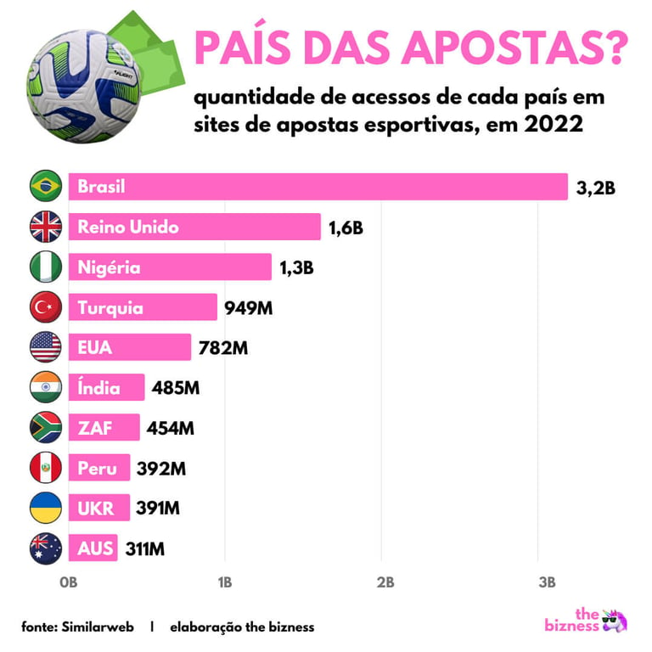


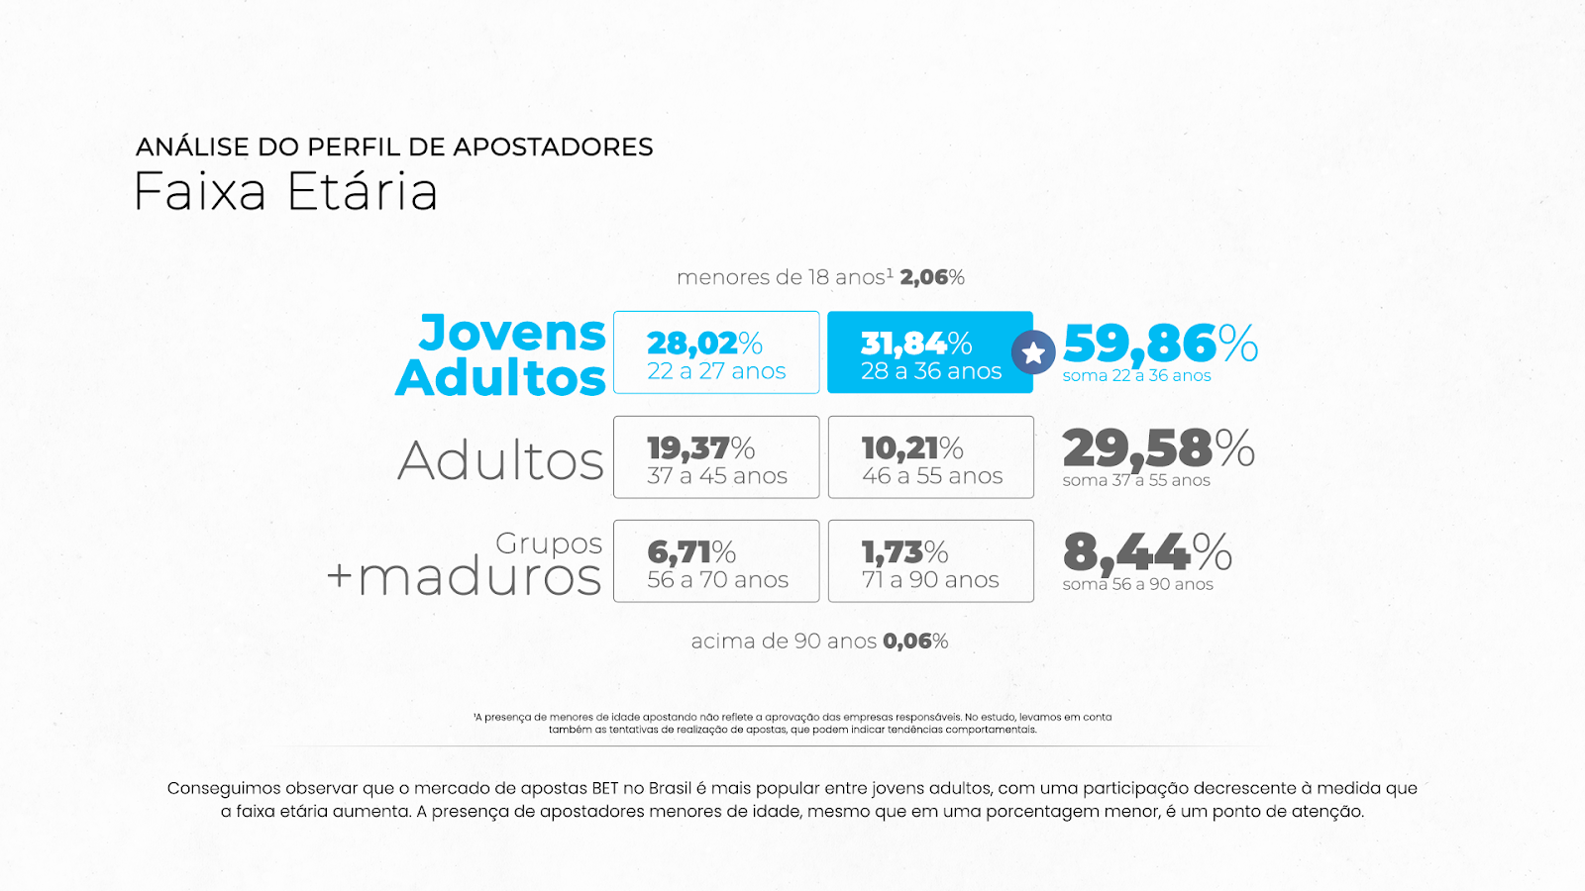
Brazil: MARKET OUTLOOK
Brazilian betting market in acute growth mode
# TOP 5 countries for SPORT BETTING SITE ACCESSES
135%
Market growth in 2023
Brazil is the country with the most accesses to sports betting sites,and is already, even in the scaleup phase, one of the largest online betting markets in the world.
~35B USD
Bets made by Brazilians last year
The total betting market size is estimated in 120B BRL (~25B USD) just in Brazil, with another 50B (10B USD) of bets made internationally (growth of ~20% aa)
70%
Sector revenue growth
Sector revenue was estimated in BRL 13 billion of bets in the country in 2023, an increase of 71% over 2021
Brazil
UK
Nigeria
Turkey
USA
India
Almost 25% of visits to sports betting sites around the world come from Brazil (2022)
SA
Peru
UKR
AUS
Source: SimilarWeb
Notes:
https://www.gamesbras.com/apostas-online/2022/8/3/bet365-lidera-ranking-de-sites-de-apostas-mais-procurados-pelos-brasileiros-no-google-31987.html
https://neofeed.com.br/negocios/o-que-esta-em-jogo-no-mercado-de-r-100-bilhoes-das-bets-no-brasil/
https://propmark.com.br/qual-e-o-publico-que-faz-apostas-esportivas-no-brasil/

Slide 16

Brazil: MARKET OUTLOOK
Digging into the data
Population: Between 15%-40% of Brazilians say they regularly bet or have already bet online. The average monthly expenditure among the total number of people who bet is R$ 263 - equivalent to 20% of the minimum wage in 2023. Three out of ten bettors spend more than R$100 per month (Datafolha, XP).
Amounts: 80% said they allocate up to R$ 100 per bet.
Sports: 80% of Brazilians who play on the platforms bet on football, a modality that has a wide advantage over the others – followed by electronic sports with 13%, and basketball, with 12% (Aposta Legal Brasil).
Sports market growth: Between 2020 and 2022 alone, for example, the sports betting industry increased by 360% in the country, with growth in the number of companies from 51 to 239, according to this year's survey published by Datahub.
And it´s not just sports: 80% of betting revenue comes from virtual casino games.
BETTING SPONSORS IN FOOTBALL IN BRAZIL
At least 25 clubs are sponsored by betting companies
In the 20/21 season, 14/20 Series A teams were sponsored by Betting firms
It is estimated that these firms make up over 60% of all sponsorship in Series A and Series B clubs
Nos últimos anos, as empresas de apostas esportivas “dominaram” o futebol — seja por meio do patrocínio de campeonatos ou de times.
Para te dar uma ideia, todos os 20 clubes que disputaram a Série A do Campeonato Brasileiro do ano passado tinham algum patrocínio de casas de apostas.
O valor de patrocínios de sites de apostas aos clubes brasileiros da Série A em 2023 supera a casa dos R$ 330 milhões por ano, segundo publicação do UOL Esportes.
Notes:
https://www1.folha.uol.com.br/
esporte/2024/01/brasileiros-gastaram-mais-de-r-50-bilhoes-em-apostas-online-em-2023.shtml
https://exame.com/esporte/como-o-mercado-de-apostas-se-sustenta-com-o-fim-dos-campeonatos-esportivos-no-brasil/

Slide 17
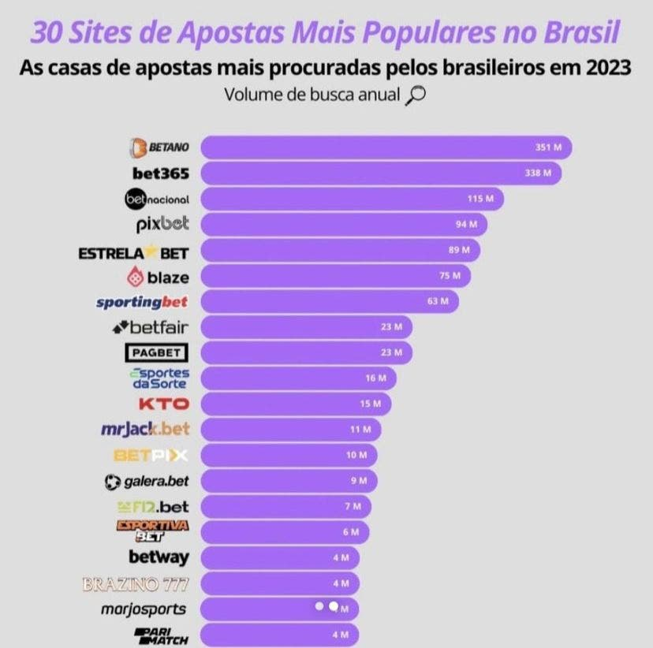
Brazil: MARKET OUTLOOK
Largest Betting companies: Most popular sites by internet search (2023)
351M
338M
115M
94M
89M
75M
63M
23M
23M
16M
Source: Netflu
Notes:
https://www.netflu.com.br/patrocinadora-master-do-fluminense-e-a-casa-de-apostas-mais-pesquisada-no-brasil-em-2023/#google_vignette

Slide 18
Brazil: MARKET OUTLOOK
Technology & Internet Access
Regulation
Diversity of Co´s and sports
Drivers
Betting Type Options
Smaller Bets
Easy Payment Options

Slide 19

Brazil: MARKET OUTLOOK
Recent M&A Activity and News
After the Betting Law, companies expect IPOs and investors in the area
Esportes da Sorte targets the Brazilian digital market and adquires Grupo Loyalty
Better Collective acquires the leader in Brazilian sports media company Torcedores.com
Flutter hints at M&A in Brazil to shore up market position
Notes:
https://fusoesaquisicoes.com/acontece-no-setor/esportes-da-sorte-adquire-grupo-loyalty/
https://fusoesaquisicoes.com/rumo-ao-ipo/apos-pl-das-apostas-empresas-esperam-ipos-e-investidores-na-area/
https://fusoesaquisicoes.com/business/ma-de-apostas-esportivas-alteracoes-de-participacao-de-mercado-esperadas-em-2024/
https://fusoesaquisicoes.com/acontece-no-setor/better-collective-adquire-torcedores-com/

Slide 20





Brazil: MARKET OUTLOOK
Trends in M&A: The Brazilian betting market is seeing an acute trend towards an increasing number M&A among national and international operators.
National Presence
National x Global
The legal requirement that companies must have a Brazilian shareholder to obtain an operating license is expected to foster M&A in Brazil
Although there will likely be increased competition from global companies, local operators in Brazil's sports betting market can compete successfully using a variety of strategies. Such tactics might make it possible for them to become the industry's "local champions.“
01
05
Value Chain
Regulatory Cost
02
The business-to-business (B2B) value chain is poised for investment, with development and consolidation expected to continue over the medium term.
04
The M&A trend is driven in part by the substantial regulatory costs associated with the licensing process, including authorization fee that can reach BRL 30 million (thirty million Brazilian reais), technical certifications, and tax obligations. Collectively, these factors pose a significant challenge to the economic sustainability of smaller betting operators.
03
Consolidation and IPOs
The number of sites is expected to fall, as happened in Colombia.We can expect large scale changes, ranging from marketing to the large-scale deployment of private equity investments, as well as access to the capital markets, including future initial public offerings.
Notes:
https://articainvest.com.br/en/publicaco
https://www.bicharaemotta.com.br/en/brazils-betting-ma-key-legal-insights/es-clair/ma-no-mercado-de-apostas-esportivas/

Slide 21
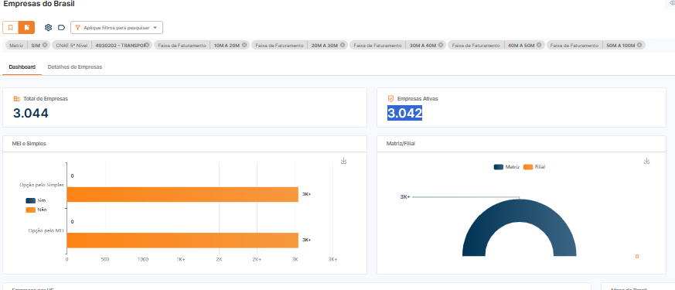


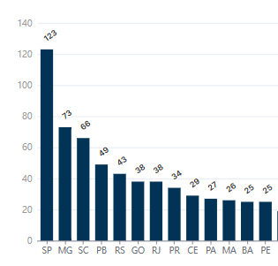
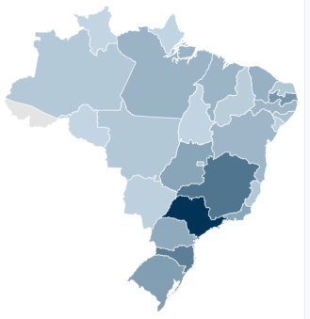
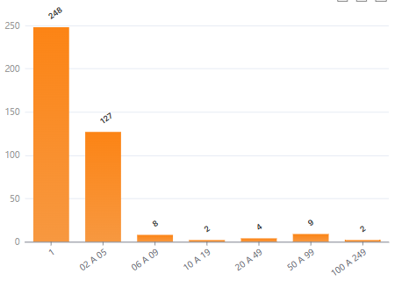
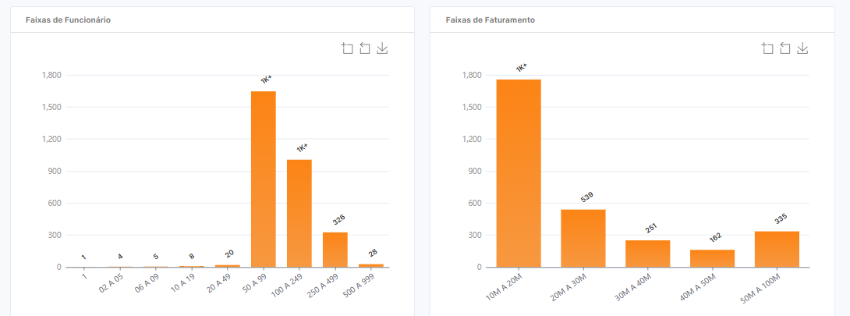
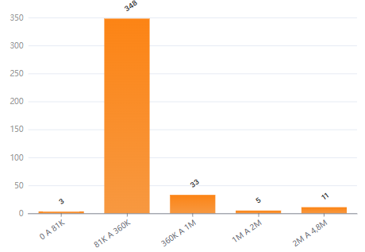
Brazil: MARKET OUTLOOK
Addressable Market : Map of the Brazilian Online Betting Segment
CNAE: 92.00-3-99 (5° Nível)
Betting Games
EXPLORAÇÃO DE JOGOS DE AZAR E APOSTAS NÃO ESPECIFICADOS ANTERIORMENTE
383
Active Companies
Redirection analysis (May 2024)
CNAE 5º: 92.00-3-99-EXP
Companies by State – Top 12 States
Drill Down – Companies by FTE
Drill Down – Companies by Revenue
1,8K+

Slide 22
BrazilianE-gaming market OUTLOOK

Slide 23
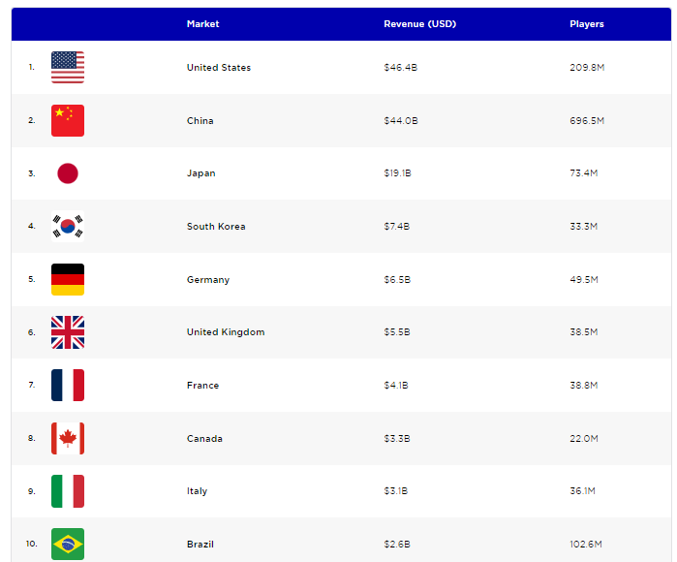
Brazil: MARKET OUTLOOK
At a Glance: Brazil is one of the top Online Gaming markets (2023)
Market Revenue (USD B) #Players
Notes:
https://newzoo.com/resources/rankings/top-10-countries-by-game-revenues

Slide 24






Brazil: MARKET OUTLOOK
At a Glance: e-Gaming sector in Brazil
Latin America’s largest economy is also one of the world’s biggest and fastest-growing gaming markets. Brazil’s i-gaminggame market is booming, driven by a growing middle class and increasing access to technology.
~$ 2 Bi
Size of Brazilian Online Gaming Market
2x
~74%
169%
5th
The Brazilian gaming market is forecast to double over the next 4-5 years
73,9% of Brazilians play videogames
Game sector growth between 2018-2022
Largest global market with over 100M consumers
2024-
2025
Notes:
https://www.iea.org/reports/renewables-2023/executive-summary
https://isolaralliance.org/uploads/docs/1885d3247cb1a2c5c86d9bf1599a66.pdf
https://www.iea.org/reports/world-energy-investment-2023/overview-and-key-findings

Slide 25
Brazil: MARKET OUTLOOK
At a Glance: Forecasting the e-Gaming Market in Brazil (USD B)
16,51%
average annual growth expected to 2028
Notes:
https://saojoaquimonline.com.br/variedades/2024/02/14/o-crescimento-dos-casinos-online-no-brasil/

Slide 26



Brazil: MARKET OUTLOOK
Online e-Gaming segment
KEY STATS
Favorite online casino games are Slots, Roulette, Poker and Blackjack.
The most common way to bet is online or via mobile apps (86.4%), followed by bets made between friends (21.1%) and bets made in physical locations (13.5%).
The main motivation for betting is to make money (53.8%), followed by enjoying the excitement (42.3%) and being more interested in watching or following a game (36.1%).
The number of users in the online gaming market in Brazil is expected to reach 2.3 million users by 2028.
Casino Gaming
Online Poker
Lotteries
Although physical casinos are still prohibited in Brazil, online casino games have gained popularity. It is estimated that the online casino games market in Brazil generates billions of reais annually. With adequate regulation, this market is expected to see considerable growth over the coming years.
Online poker is also a popular form of gambling in Brazil. It is estimated that the online poker market generates significant activity, with tournaments and cash game tables available to Brazilian players.
Lotteries are a traditional form of gambling in Brazil and are administered by Caixa Econômica Federal. The lottery market turnover in Brazil is estimated in billions of reais annually, with games such as Mega-Sena, Quina and Lotofácil being widely known and played by Brazilians.

Slide 27
Brazil: MARKET OUTLOOK
Generative AI in betting
Betting on
Demand
E-Sports and gaming
profession
M&A
VR & AR
Trends
Micro-
Payments
Retro &
Remakes
Portable devices
GaaS
Collab & Creative
Betting

Slide 28




Brazil: MARKET OUTLOOK
At a Glance: Investment Opportunities in the e-Gaming market
01
02
03
04
Operations
Software
Marketing
Payments
Invest in the opening and operation of online casinos in Brazil. This can be done by creating a new platform or acquiring an existing platform.
Software development for online casinos is another promising area for investment. Companies that develop games, payment platforms and other technological solutions for the sector can have great growth potential.
Marketing and affiliation are essential tools for the success of an online casino. And agencies that work in these areas can help casinos reach new customers and grow their player base.
Online casinos need safe and reliable payment solutions to offer their customers. Therefore, companies that provide these services can also benefit from the growth of the sector.

Slide 29












Brazil: MARKET OUTLOOK
At a Glance: Key Cassino & Poker firms in Brazil

Slide 30

Brazil: MARKET OUTLOOK
Recent M&A Activity and News
Epic Games buys Aquiris, which is now called Epic Games Brasil
Los Grandes buys Team oNe; market value reaches R$ 134 million
Brazil leads investments, mergers and acquisitions in games and e-sports
Notes:
https://fusoesaquisicoes.com/acontece-no-setor/esportes-da-sorte-adquire-grupo-loyalty/
https://fusoesaquisicoes.com/rumo-ao-ipo/apos-pl-das-apostas-empresas-esperam-ipos-e-investidores-na-area/
https://fusoesaquisicoes.com/business/ma-de-apostas-esportivas-alteracoes-de-participacao-de-mercado-esperadas-em-2024/
https://fusoesaquisicoes.com/acontece-no-setor/better-collective-adquire-torcedores-com/

Slide 31
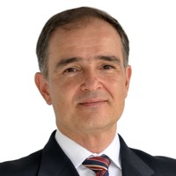


REDIRECTION – SENIOR UK INTERNATIONAL TEAM
Redirection have full-service offices in Brazil and the UK
Joao Caetano Magalhães
Adam Patterson
Simon Davies
Senior Partner
Redirection International
30 years experience in M&A
Graduate of Business Administration from Fundação Getúlio Vargas, holds a post-grad in Marketing from UCB (University of California Berkeley) and Masters in Strategic Business from PUC-PR.
Based in Curitba, Brazil
Partner
Redirection International
15 years experience in Corporate Finance, Banking and M&A
Graduate of Politics & Parliamentary Studies from Leds University, holds a post-grad in Economics from Birkbeck University/LSE and MBA from UFPR
Based in Curitba, Brazil
Senior International Associate
Redirection International
30 years experience in banking, trade finance and global capital markets
Graduate of International Business from the University of Bedfordshire and holds an MBA from the University of Birmingham
Based in London, UK
☎: +44 800 060-8702
📩 Tower 42, 25 Old Broad St.
London
Notes:
M&A geral, cros border, top paies, prvate equity... % cross
Global M&A Industry Trends: 2023 Outlook : PwC
https://capitalinvest-group.com/en/invest-in-brazil-ma-guide/
https://valor.globo.com/empresas/noticia/2023/01/05/fusoes-e-aquisicoes-caem-12percent-no-brasil-com-menor-apetite-por-tecnologia-em-2022-diz-kpmg.ghtml

