Slide 1
Brazil Economic Overview
Brazilian Chamber of Commerce
Reinaldo Le Grazie
Deputy Governor for Monetary Policy
London, United Kingdom
November, 2017

Slide 2
Summary
International Overview
External Sector
Monetary Policy
Credit Market
Economic Activity and Business Environment
“Agenda BC+”
2

Slide 3
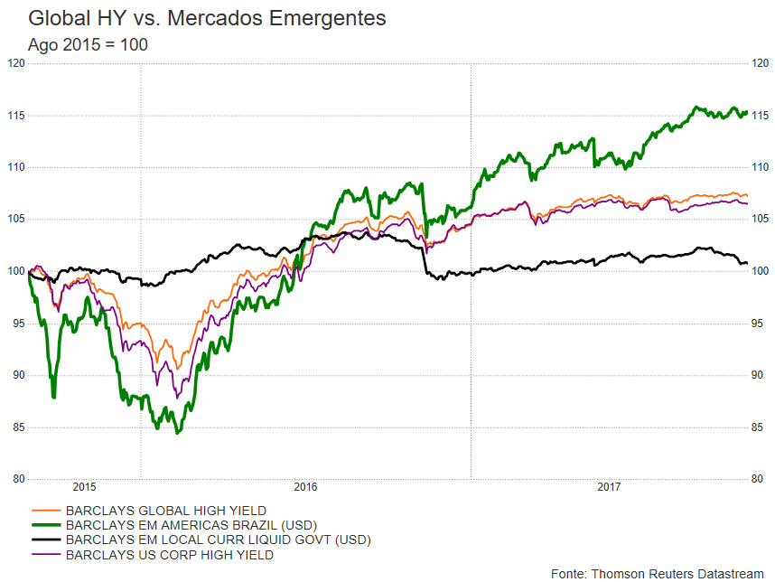
International Overview
HY vs. Emerging Markets Indexes Fixed Income: total return
CDS 5 years - Sovereign
*As of November 6th
Source: Thomson Reuters Datastream
*As of October 31st
3

Slide 4
International Overview
Growth Recovery
Global
Advanced economies
Emerging and developing economies
Latin American and Caribbean economies
Source: International Monetary Fund, World Economic Outlook Database, April 2017
*Projection: 2017/2018
4
Notes:
IMF - Gross domestic product, constant prices
Percent change

Slide 5
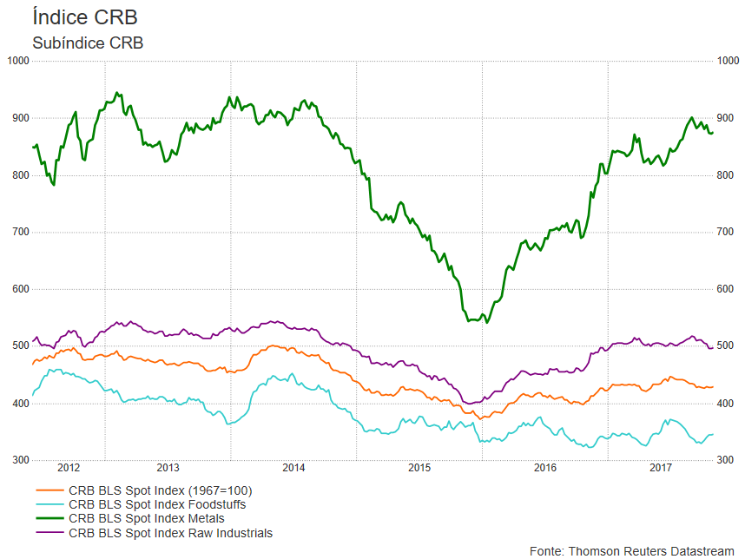
International Overview
Commodities
CRB index and sub indexes
Grains, Production and Cropped Area
CRB BLS Spot Index (1967=100)
CRB BLS Spot Index Foodstuffs
CRB BLS Spot Index Metals
CRB BLS Spot Index Raw Industrials
*As of November 6th
Source: Thomson Reuters Datastream
*average estimate in Aug 17
Source: Conab
5
Notes:
Produção: ALGODÃO – CAROÇO, AMENDOIM, ARROZ, AVEIA, CANOLA, CENTEIO, CEVADA, FEIJÃO, GIRASSOL, MAMONA, MILHO, SOJA, SORGO, TRIGO, TRITICALE

Slide 6
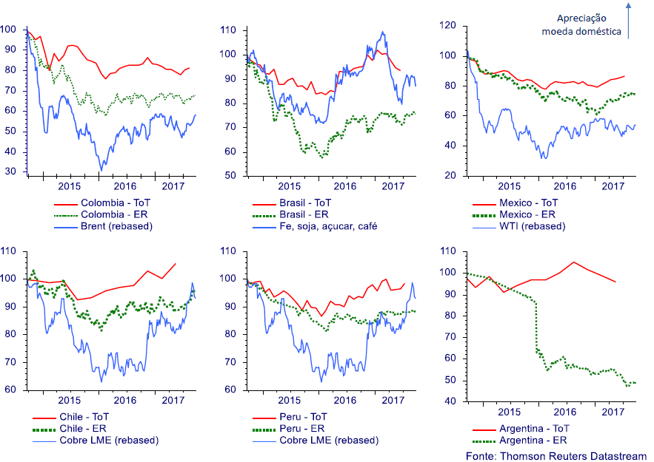
International Overview
Latin America
Terms of Trade (ToT) and Exchange rates (ER)
Local currency appreciation
Source: Thomson Reuters Datastream
6

Slide 7
External Sector
Commerce
2006=100
Terms of Trade
Trade Balance – Exports and Imports
US$ billion
**market expectations
2017 to 2021
Source: Funcex
Source: MDIC/BCB(Focus)
*12 months until Sep 17
**as of October 27th

Slide 8
External Sector
Exports by Destination
Oct/16 – Sep/17
12m until Sep/17
 | Exports/GDP
Total exports | 10.6%
Latin America and the Caribbean | 2.1%
EU | 1.7%
Ásia (ex-ME and China) | 1.4%
US | 1.3%
China | 2.4%
others | 1.6%
Oct/16 – Sep/17: US$210.5 billion
8

Slide 9
External Sector
Current Account
Net Foreign Investment Flow, by Category
US$ billion in 12 months
% of GDP
US$ billion
Source: BCB
From 1995 on, methodology according to BPM6
* BCB forecast
new methodology since 1995
9

Slide 10
External Sector
International Reserves and FX Swap
US$ billion
Source: BCB
*through October 26th
10

Slide 11
External Sector
FX Swaps
Source: BCB
*through November 6th
11

Slide 12
Fiscal
Public Debt Ceiling
12

Slide 13
Fiscal
Public Debt
% of GDP
Source: BCB
*As of November 6th
13

Slide 14
Monetary Policy
Inflation Targets
% a.a.
Source: BCB/IBGE/FIPE/FGV
*Median market expectations as for Nov 3rd
14

Slide 15
Monetary Policy
Real Interest Rates
360-day market rate discounted by the IPCA expected for the next 12 months (Focus)
% p.a.
October27th
3.0%
15

Slide 16
Monetary Policy
Latin America Basic Interst Rates
16

Slide 17
Credit Market
Credit / GDP
2009-2016: 12.2%
(nominal credit average growth)
2005-2008: 25.4%
(nominal credit average growth)
% of GDP
Source: BCB
new methodology since Mar 07
*Sep17
17

Slide 18
Credit Market
Credit Interest Rate and Spread
Individuals
Corporate
p.p.
% p.a.
p.p.
% p.a.
Source: BCB
18

Slide 19
Credit Market
Household Debt and Debt Service
% of income
Source: BCB
19

Slide 20
Economic Activity and Business Environment
GDP Real Growth
%
Source: BCB
*Median market expectations as for Oct 27th
20

Slide 21
Economic Activity and Business Environment
Growth Recovery
Retail Sales:
seasonally adjusted
Industrial Production:
seasonally adjusted
2012 = 100
2008 = 100
12 months through Aug 17 /
12 months through Aug 16*
12 months through Sep 17 /
12 months through Sep 16*
Retail sales
-1.5%
Industrial Production
0.4%
Broad retail sales
-1.6%
Capital Goods
3.9%
Sources: IBGE
*As of August/2017
21

Slide 22
Economic Activity and Business Environment
Room for Growth
Unemployment vs. Real Earnings
Industrial Capacity Utilization
Seasonally adjusted
%
% of labor force
% (Q/Q-4)
last month of the quarterly moving average
Source: FGV
Source: FGV
22

Slide 23
Agenda BC+
Business environment and efficiency
Lowering the cost of credit in the system, reducing compliance costs
  Cooperation in financial infrastructures
  Simplification of reserve requirements rules and calculations
  Segmentation of banking regulation
Stimulating operations with collaterals
  Greater security and efficiency in credit deals guaranteed by receivables
  Improvement of financial assets issued by financial institutions
  Covered bond (LIG)
23

Slide 24
Agenda BC+
Monetary Policy Framework
Greater effectiveness of Monetary Policy
  Voluntary Deposit in the CB, as an auxiliary instrument
  Modernization of the base rate for earmarked loans
Communication and transparency
  The language has become clearer and more direct
  The balance of risks to inflation has gained a more prominent role, and additional scenarios have been presented
  The informational content of the Copom statement has increased substantially
  Inflation projections are now disclosed in both the minutes and the statement of the Copom meeting
  The minutes of the Copom meeting and the quarterly Inflation Report have been restructured, now shorter and with a more direct language. The date of release of the Copom minutes has been brought forward by two days
24

Slide 25
Agenda BC+
Efficiency and Innovation
  Promotion of financial citizenship
  Support innovation in payment systems with cost reduction in the process
  Increase the offering of financial products
  Modernization of foreign exchange contracts process
  Revision of the legal framework for punitive actions
25

Slide 26
Thank you!
Reinaldo Le Grazie
Deputy Governor for Monetary Policy
Central Bank of Brazil
26

