Slide 1




Brazil Biofuels Seminar
Financing the Biofuels Sector: Opportunities & Challenges
Mrs. Luciana Costa
Managing Director of Infrastructure, Energy Transition and Climate Change
October, 18th, 2024
PUBLIC DOCUMENT

Slide 2
1
Brazil’s Unique Position & BNDES Role in a World in Transition

Slide 3





Brazil offers high potential to become a global Green & Low Carbon Power
brazil has significant comparative advantages to become a carbon neutral economy
Global Biofuel Powerhouse
#1 Biofuel Consumer
#2 Ethanol Producer
#4 Biodiesel Producer
> 90% of Brazil’s light vehicles are dual-flex
Strong Government Support
Federal government top priority
Alignment with subnationals, private sector and civil society
Ecological Plan, with green taxonomy & sustainable bonds issuance
BNDES – Largest Development Bank in Latin America
Geopolitical Stability
Well stablished democracy
Diplomatic relations with all UN countries
150 years without wars with neighbors
5th and 7th world’s largest territory and population
Abundant Resources & Food Security
#1 Tropical Forest
#1 Biodiversity
#1 Fresh Water
#3 Food & #4 Grains producer
#1 Beef, Soybeans, Coffee and Sugar exporter
Clean Energy Matrix and Key Minerals Reserves
G20’s cleanest energy & power matrixes
Globally competitive wind and solar LCOE
Mineral reserves (#2 iron ore, #3 nickel, #7 lithium)
Interconnected system + Hydro serving as batteries
PUBLIC DOCUMENT

Slide 4


Brazil has shown a strong economic performance in 2023 in the key macroeconomic indexes
GDP 2023 US$ 2.13 trillion ↑ 3.1% YoY (2023E vs. 2022) Source: IMF - World Economic Outlook | Local CPI (“IPCA”) 4.24% p.a. Lowest local inflation level since 2020 Source: IBGE - IPCA Last 12m (Aug/2024) | Unemployment | Labor Force 6.8% | 102 million people Lowest unemployment level ever & historical record of occupied labor force Source: IBGE (Jul/2024)
Base Interest Rate (“Selic”) 10.75% p.a. | ↓ 300bps Source: Brazil’s Central Bank (May/2024) | Trade Surplus | FDI 2023¹ US$ 99bn | US$ 62bn Historical record of trade surplus and exports (1) FDI = Foreign Direct Investment Source: MDIC (Dec/2023) & Bacen (LTM – Dez/23) | Sovereign Credit Ratings BB | BB | Ba1 Rating upgraded by S&P, Fitch and Moody’s (1-notch below IG level) Source: S&P, Fitch and Moody’s
PUBLIC DOCUMENT
4

Slide 5





BNDES: The Brazilian National Development Bank
100% state-owned bank by Brazil’s Federal Republic.
Largest National Development Bank in Latin America
~US$156bn Assets
~2,400 employees
Main provider of long-term financing in Brazil, since 1952.
Key instrument of the official industrial and infrastructure policies.
Corporate Ratings: BB | Ba1 (S&P | Moody’s, both capped by Brazil’s sovereign rating).
PUBLIC DOCUMENT

Slide 6
Financial Highlights: BNDES has a solid balance sheet and credit portfolio, with robust Basel ratio and very low delinquency ratios
Total Assets (Jun/2024) USD 156bn | Credit Portfolio (Jun/2024) USD 106bn | Equity Portfolio (Jun/2024) USD 16.5bn
New Worth (Jun/2024) USD 32bn Recurring ROE (Jun/2024) 10.2% | 2023 Credit Approvals (Loans+ Guarantees) USD 44 bn 2023 Total Drawdowns USD 23 bn 2023 Credit Requests USD 54 bn | BB | Ba2 S&P & Moody’s Credit Ratings 31.2% Basel Ratio 0.07% Delinquency Rate
Note: Figures in US$ (US$ 1.00 = BRL 5.00)
PUBLIC DOCUMENT
6
Notes:
https://www.bndes.gov.br/wps/portal/site/home/imprensa/noticias/conteudo/bndes-viabiliza-rs-218%2C5-bilhoes-em-aprovacoes-de-credito-em-2023-44-por-cento-a-mais-que-em-2022/!ut/p/z1/zVTBbtwgEP0a38pCAK_d3tw0atQkzaFJN-tLhPF4TbWAF1i7ydd3vMmparqqokjlgmYG3nu8GUFrekdrp0azUcl4p7YYr-vl_eX7i7Nzec0uWX4jWfVJFPK2OGMXJaffaU1r7dKQerpuXAvx3riYTNrrA0LGem8hY8YOAVxUGXM-GW1UzJj2LsG-9Rk7XCSjUY3ZmkdFQiT8pHyXE4x7jyWwRA3Bj0rPUQtEB2hN8nOBMy6IlGTwgWhwmFTEKhPJbg_PdT6rHLRp6ZqLtmuh1EQseUck5JwowXMCuWx0kTfLEwF0dezZNZbZC6tieL8-dmSNFMWLFNecrkYDE711PlhsxLd_fMH5UYb8lQxH4Is3hZfylfBfDv35S4dx8s2P3a6ucLznOf2Z6N1_PN8ol4er06sNuqBST4zr_LPgN-VFHzdb3zx9FZVrRIkKAnQQICz2AdN9SkP8kLGMTdO0OChabPy4aAJmBrQJ8dNsZDQJnuz8E1bvI3bgdwg6WFuKB-IeP34ln0-bcrrpLG4PYjvaVRmrX4L6gAY!/dz/d5/L2dBISEvZ0FBIS9nQSEh/

Slide 7

BNDES is pioneer and leader in Green Finance in Brazil and worldwide…
ESG Rating A1+ ( Moodys ): BNDES positioned among the top 2% in the world
1st Brazilian Institution to issue Green Bonds in the international market (US$ 1bn, in 2017)
1st Financial Institution to issue Green Financial Bills in the Brazilian market (BRL 1bn, in 2020)
Bloomberg/BNEF Global Banking Ranking (Renewable Energy Finance 2004-2023)
PUBLIC DOCUMENT

Slide 8


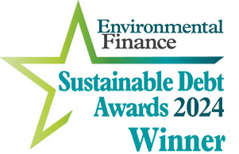



BNDES has been recognized locally and internationally with several “Deal of the Year” Awards, as well as the Bond Arranger & Public Sector of the Year
Latin Finance 2023
BNDES Institutional Awards
2023 Bond Arranger of the Year - Latin America (by IJ Global Awards)
2022 Public Sector of the Year - Latin America (by IJ Global Awards)
Deals of the Year Awards
Águas do Rio (R$ 19bi BNDES Financing): 2023 Water Financing of the Year (Latin Finance & IJ Global), 2024 Sustainable Project Bond of the Year (Environmental Finance), 2023 BRL Deal of the Year (Bonds & Loans)
Babilônia Centro (R$3.2bi BNDES Financing): 2023 LatAm Loan of the Year (Latin Finance)
Aeroportos Sul & Central (R$ 4.65bi BNDES Financing): 2023 LatAm Airpot Deal of the Year (Latin Finance)
SP Lines 8 & 9 (R$ 4.6bi BNDES Financing): 2023 LatAm Transport Deal of the Year (IJ Global)
Metrô SP Line 6 (R$ 6.9bi BNDES Financing): 2022 Infrastructure Financing of the Year: Brazil (Latin Finance) & 2022 LatAmTransport Deal of the Year (by IJ Global)
Ecovias do Araguaia (R$ 3.8bi BNDES Financing): 2022 LatAm Local Currency Deal of the Year (Latin Finance)
UTE GNA II (R$3.9bi BNDES Financing): 2022 LatAm Power Deal of the Year (Latin Finance)
PUBLIC DOCUMENT

Slide 9
2
Sustainable & Advanced Biofuels

Slide 10



Biofuel Opportunities
Brazil has a long tradition in the production of biofuels, with incentive programs for ethanol and biodiesel since the 1970s...
Brazil has a long biofuels production tradition, with incentive programs for ethanol and biodiesel since 1970’s...
2002
Gas/ethanol dual Flex fuel vehicle is launched
“Pro-biodiesel” incentive program is created
Future’s FueL Program
Higher Ethanol & Biodiesel mandates
SAF: 1 to 10% Mandate starting in 2027
HVO/Renewable Diesel (TBD)
US$10 billion investments in biorefineries, SAF, HVO & 2G ethanol plants
1975
“Proalcool” Ethanol Incentive Program is created
2016
Renovabio’s carbon credit program is launched
GLOBAL BIOFUELS ALLIANCE
1st ethanol blending mandate (22%)
1993
1st biodiesel blending mandate (2%)
2008
Ethanol: 27% Biodiesel: 12-15%
2023
PUBLIC DOCUMENT

Slide 11
... Brazil is #1 consumer and #2 producer of biofuels in the world and may become a leading producers of advanced biofuels and sustainable aviation fuel ("SAF")
We are top3 producers and consumers of biofuels in the world, with potential to become a major SAF & HVO player as well
#2 World Ethanol Producer
#4 World Biodiesel Producer
21.4%
(vs. 4.6% global average)
>90%
share of Brazil’s dual-flex light vehicles
+
=
31bi liters
39% share of light vehicles consumption
6.8bi liters
10% share of heavy-duty vehicles consuptiom
-75%
Ethanol vs. Gasoline GHG emissions
(well-to-wheel basis)
share of renewables fuels in Transport matrix
IEA estimates a 3-fold growth in the world’s demand for sustainable fuels by 2030 (vs. 2021), to ~6.0 million boe/d(1) and Brazil has a fundamental role in expanding the global supply of sustainable fuels.
(1) International Energy Agency, Net Zero by 2050: A Roadmap for the Global Energy Sector
PUBLIC DOCUMENT

Slide 12


Brazilian biomass production potential offers the opportunity to become one of the main producers of biofuels and sustainable aviation fuel (“SAF”) in the world
Sustainable biofuels offer a decarbonization route that takes advantage of existing infrastructure and fleets, extending the useful life of these assets and the deadline for transitioning to new technologies
Drop-in characteristic of biofuels allows use without the need to replace the vehicles fleet
Brazil has the 9th refining park in the world: biofuels use existing infrastructure and extend their useful life
2nd generation Ethanol plants and renewable diesel (HVO) bio-refineries with combined SAF production
US$ 10 billion+ of potential investments over the next 5-7
PUBLIC DOCUMENT

Slide 13
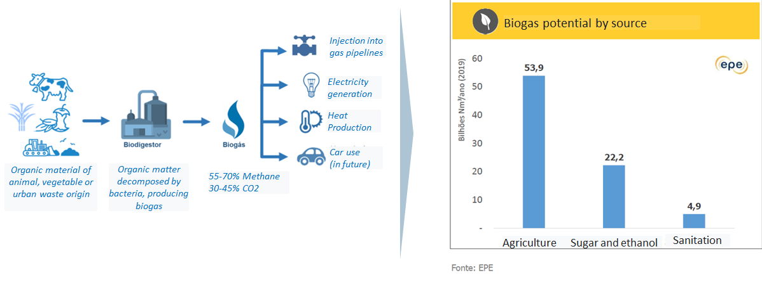
Biogas/biomethane are decarbonization routes in which Brazil has great production potential (up to 50% of country’s industrial & commercial consumption volumes) to become a top5 global producer
Biogas and Biomethane are technologies that are in the process of scaling up production in Brazil
Local industry association estimates that Brazilian biomethane production could reach 30 million m3/day by 2030, equivalent to the maximum transport capacity of the Brazil-Bolivia gas pipeline and ~50% of Brazilian non-thermal natural gas demand.
PUBLIC DOCUMENT
Notes:
https://epbr.com.br/producao-de-biometano-pode-chegar-a-30-milhoes-de-m3-dia-no-brasil-ate-2030-projeta-abiogas/
https://www.epe.gov.br/sites-pt/publicacoes-dados-abertos/publicacoes/PublicacoesArquivos/publicacao-689/topico-640/Caderno%20de%20Ga%CC%81s%20Natural%20-%20PDE%202032%20-%20rev1.pdf

Slide 14
3
Brazil’s Climate Fund

Slide 15
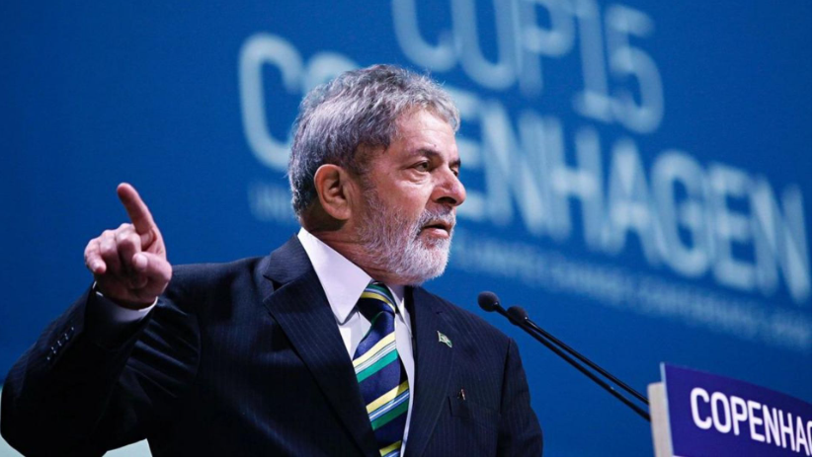
The Brazil’s Climate Fund was created in 2009 and presented internationally at COP 15 in Denmark, marking Brazil's pioneering role in climate finance
  Pioneering: Brazil was a pioneer in presenting a climate program at COP 15 in Denmark (2009)
  Great potential: Powerful instrument to reduce/mitigate emissions (environmental recovery, energy transition, innovation and urban development)
  BNDES is the fund manager of non-concessional funding (i.e. credit facilities) of the Brazil’s Climate Fund
Documento Ostensivo

Slide 16
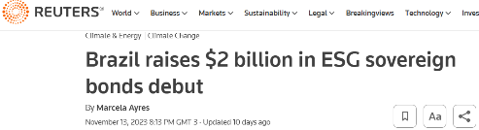
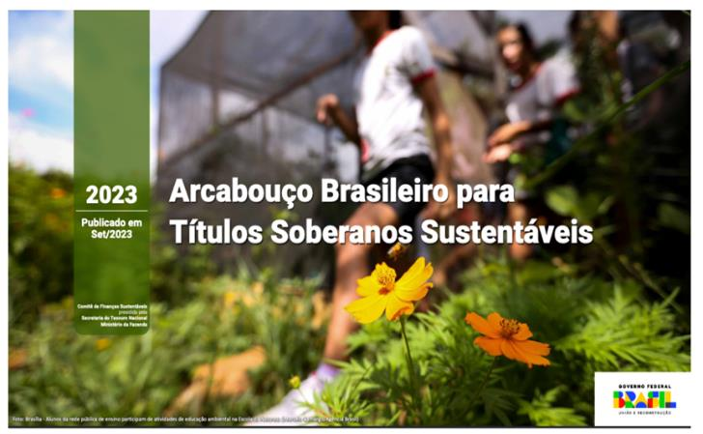
In Nov’2023, Federal Government established a new source of funding for the Brazil’s Climate Fund, through the issuance of US$ 2.0 billion Sustainable Sovereign Bonds
Brasil oferece alto potencial para se tornar uma potência global verde e de baixo carbono
On Nov, 13th, 2023, Brazil closed the BRAZIL GLOBAL 2031 ESG Bond, our first USD sustainable bond issuance in the international capital markets
Volume: US$ 2.0 billion
Maturity: Mar/2031
Coupon: 6.25% p.a.
Yield: 6.50% p.a. (182bps over the US Treasury)
.
PUBLIC DOCUMENT

Slide 17
Brazil’s Climate Fund: A Case Study of Raising International Funding in Capital Markets for Climate Finance
International Capital Markets
Brazil NationalTreasury
Brazil Climate Fund
Local Market
US$ Funding
Onlending in BRL
Onlending in BRL
USD +6.15%
6.15% (BRL Nominal Terms)
6.15% + Credit Spreads (BRL Nominal Terms)
  Brazil’s National Treasury onlends its external fundraising costs to the Brazil’s Climate Fund, assuming the cost or gain arising from exchange rate variations (USD-BRL hedge)
Documento Ostensivo

Slide 18
Brazil’s Climate Fund: Financial Costs
Areas | Base Interest Rate
1. Native Forests and Water Resources | 1.00%
2. Resilient and Sustainable Urban Development | 6.15%
3. Green Industry | 6.15%
4. Green Transport Logistics, Public Transport and Mobility | 6.15%
5. Green Services and Innovation | 6.15%
6. Energy Transition
6.1 Biomass, energy efficiency, smart grid, storage and others | 6.15%
6.2 Wind & Solar Power Generation | 8.00%
Documento Ostensivo

