Slide 1




Financial Inclusion at Banco do Brasil

Slide 2
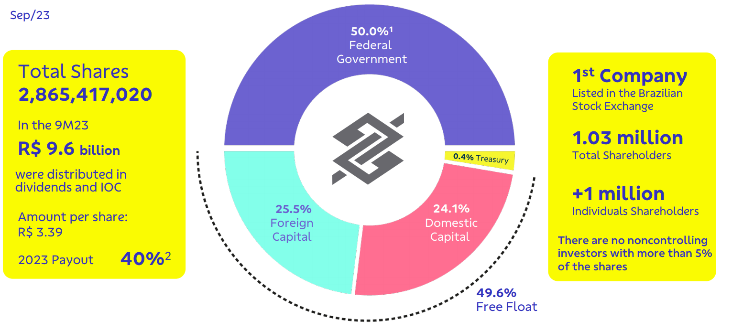
#interna
Company Profile

Slide 3


Awards
Recognised by government and regulatory agencies, associations and society

Slide 4
#interna
Financial inclusion strategy
Sustainable results
Ethics
ESG
Innovation
Omnichannel
Presence

Slide 5
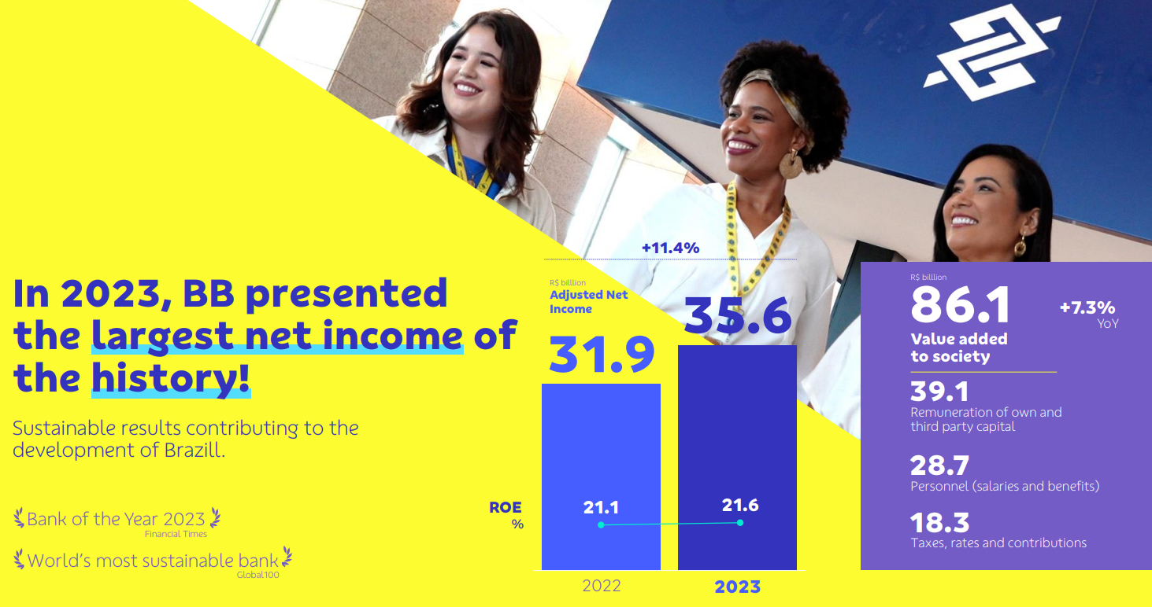

#interna
Sustainable results

Slide 6
#interna
Ethics
Ongoing training in inclusive relationship techniques and ethical sales practices
Respect is a duty, it's good and everyone likes it.
Do what's right.
You are responsible for the consequences of your actions.
What affects the company, affects you.
If you need to hide your action, it is unethical.
It is not enough to be ethical; it is also necessary to appear ethical.
When in doubt about how to act, stop and seek help

Slide 7
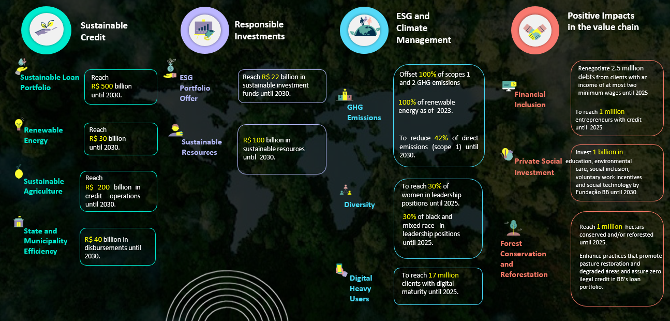
#interna
ESG
Commitments for a more sustainable world

Slide 8




#interna
ESG - Social commitment
Diversity, equality and inclusion

Slide 9
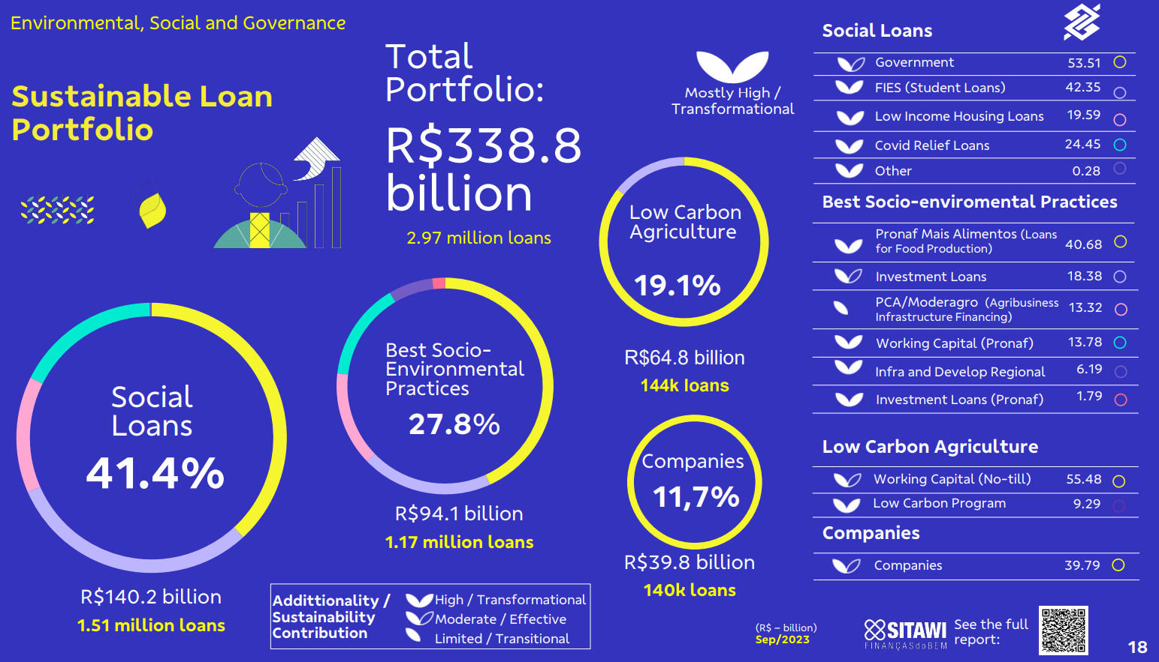
#interna
ESG - Sustainable Finance
Strong sustainable loan portfolio

Slide 10

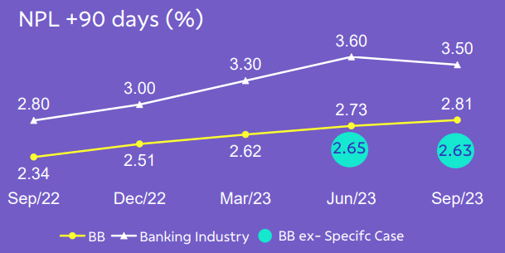

#interna
ESG - Responsible lending
Prevention of excessive indebtedness and focus on the well-being of customers

Slide 11


#interna
ESG - Banco do Brasil Foundation
Support for social projects

Slide 12
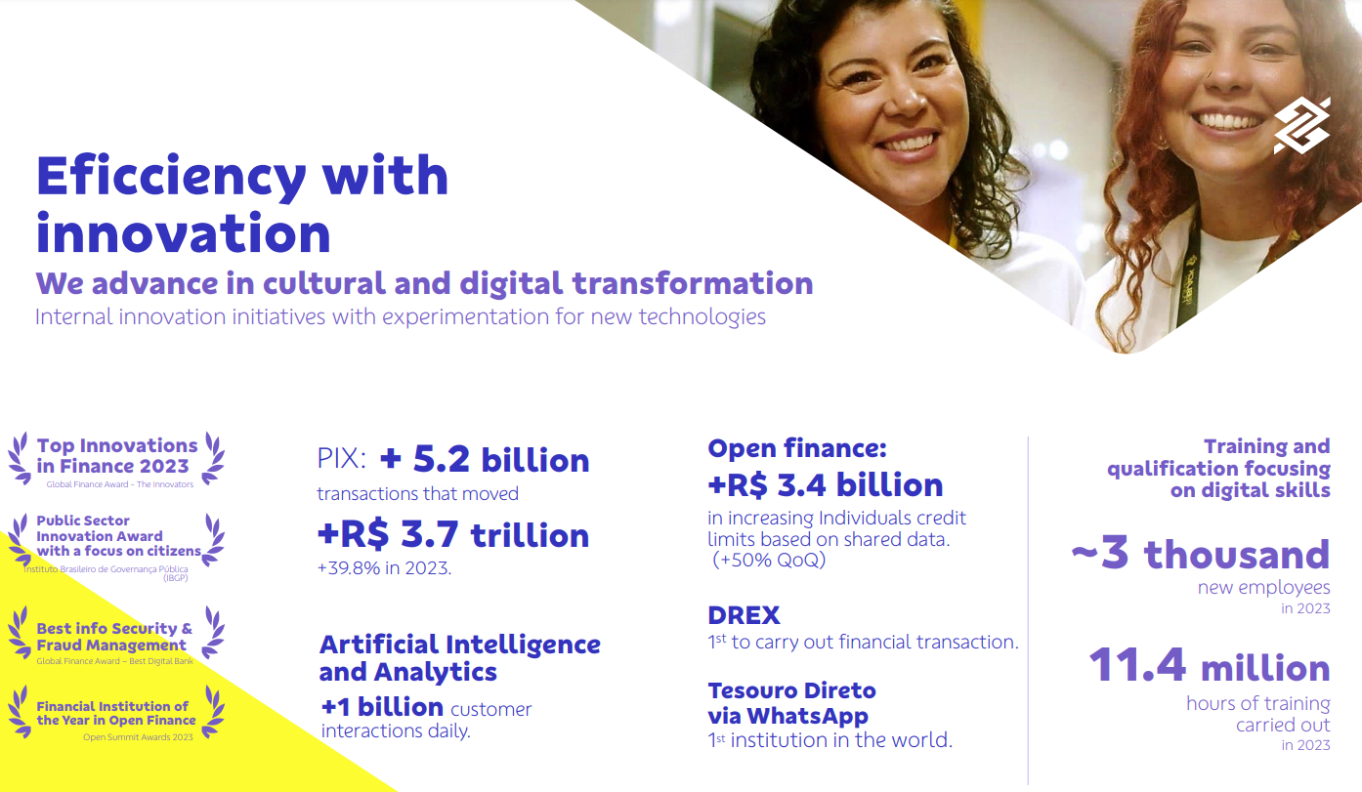
#interna
Inovation

Slide 13
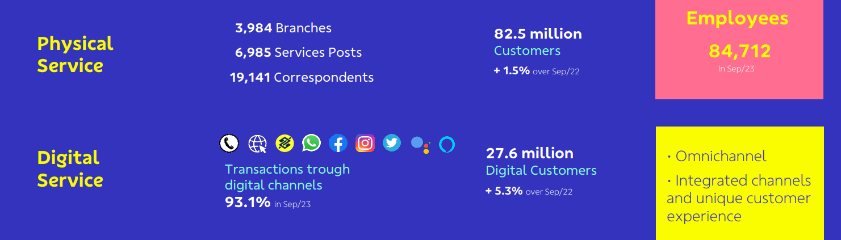
#interna
Omnichannel
Clients support is close and available across all channels

Slide 14
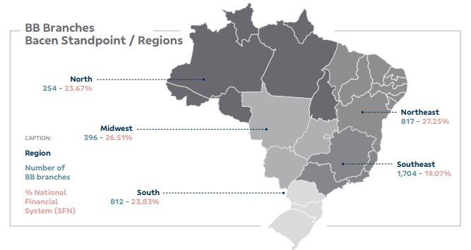
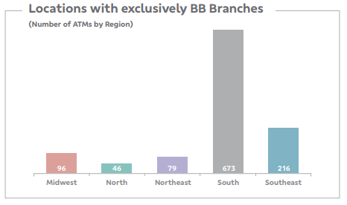
#interna
Presence everywhere
The largest network of branches, ATM and banking correspondents
International since 1941. Presence in 110 countries through its own network and banking correspondents

Slide 15



Banco do Brasil
Thank you

