Slide 1
Renewable Energy
April 2013
Legal Framework
Victor Galante
Partner
Rio: + 55 21 2127 4275
VGalante@mayerbrown.com

Slide 2
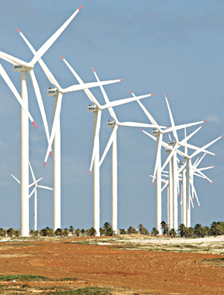

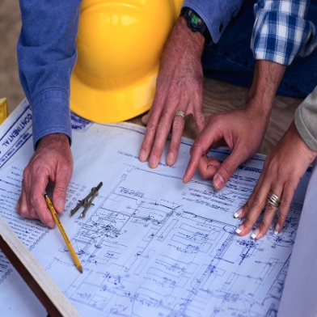
Summary
Types of Renewable Energy
Brazilian Legal System
PROINFA
Accreditation with ANEEL
Power Auctions
Environmental Matters
Taxes Incentives

Slide 3
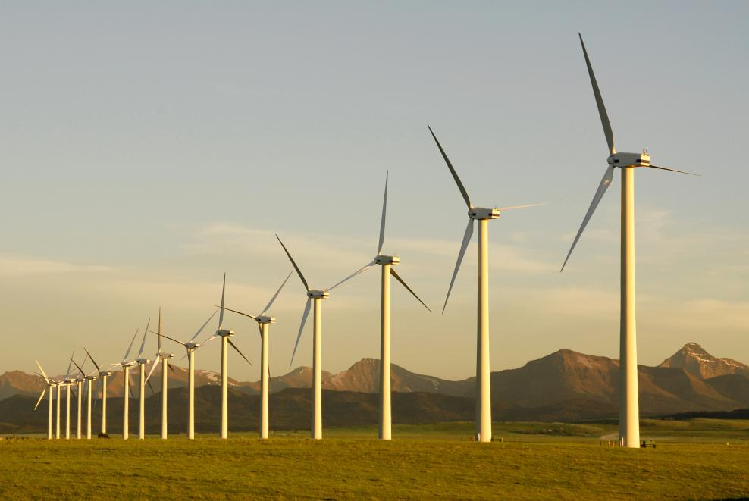
Types of Renewable Energy

Slide 4
Main types of Renewable Energy in Brazil
Biomass
Biofuels
Hydro Power
Solar Power
Wind Power

Slide 5
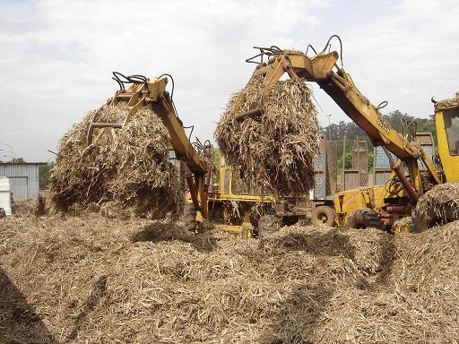
Biomass
Renewable resources of animal or vegetable organic material.
Biomass of Agricultural Crops: straw and bagasse of sugar cane (mostly used in Brazil), rice and chestnut peel, Bahia coconut, etc.
Biomass of vegetable origin: wood
Indirect form of solar light use: conversion of the sunrays into chemical energy by photosynthesis.
Brazil has natural conditions favorable to biomass production.
Advantages: the use of biomass can be done directly by the combustion in furnaces.
Challenge: development and improvement of new technologies of conversion more efficient then photosynthesis, such as pyrolysis and gasification.

Slide 6

Biofuels
Comes from renewable biomass to be used in internal combustion engines.
Can be produced by several vegetable species such as sugar cane, oleaginous plant such as soybean, corn, babassu, castor, etc. and of forest biomass.
Many types of biofuels: bioethanol, biodiesel, biogas, biomethanol, etc., synthetic biofuels and biohydrogen.
Advantages: low emission of CO2, good alternative in short term.

Slide 7
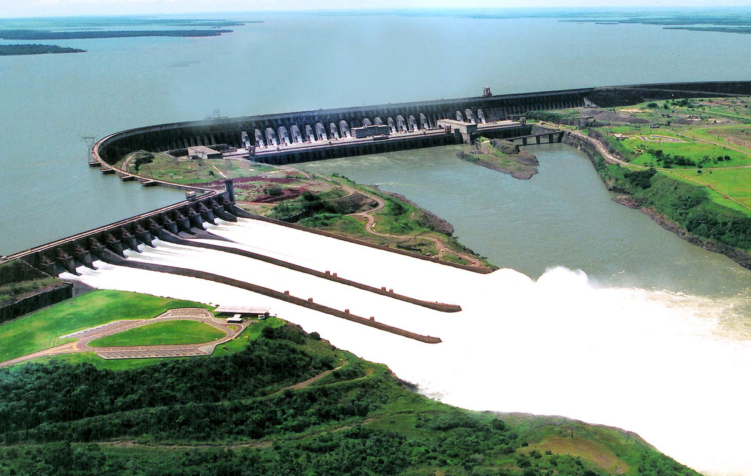
Hydro Power
The Hydro energy is produced by water.
In Brazil, the great majority of electric energy is produced by hydro power: presence of a large watershed.
Challenges: the environmental impact caused by construction of the plant.

Slide 8

Solar Power
Energy produced by the sun light
Types:
  Photovoltaic's Solar Power
  Thermal Solar Power
Advantages:
  Inexhaustible resource
  Low environmental impact
  Energy generation in the same place of the consumption: reduction of costs with transportation (40%).
Production only during the day
  battery can be use to retain the energy.

Slide 9
Wind Power
Produced by the wind strength.
Created by wind generator in which the wind strength is captured by propellers connected to a turbine that triggers an electric generator.
The amount of energy transferred is in function of:
  the air density
  the area covered by the rotation of the propellers
  the speed of the wind
To be technically usable is necessary a minimum wind speed of 7 to 8 m/s.
  This speed is only present in 13% of the earth surface.
Advantages:
  MDL (Mechanism of Clean Development): CO2 goals
  The space occupied by the wind turbines is only the base. Around it the area is available to agriculture and livestock.

Slide 10
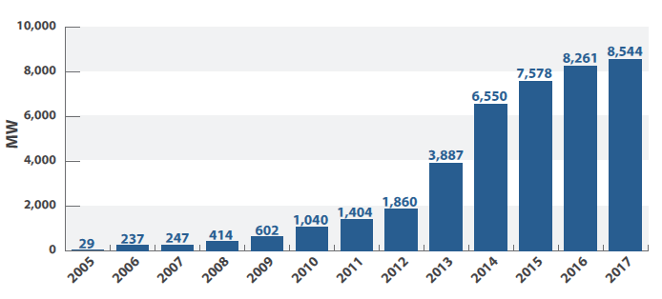
Wind Power
The development of wind power in Brazil
Operating and contracted capacity
To be contracted in 2013-2017 auctions
Capacity (MW) | Investment (US$ billion)
5,720 | 11.9
Source: Ministry of Finance

Slide 11

Brazilian Legal System

Slide 12
Brazilian Legal System
Federative Republic
  There is no hierarchy: each level has authority to legislate within its sphere of competence:
    Federal Union: General Rules
    States: Self Organization and Specific Rules
    Municipalities: Issues of Local Interest
Federal Union
3 Levels of Government
States / Federal District
Municipalities

Slide 13
Brazilian Legal System
Regulatory Agencies
Public legal entities constituted by means of law, with political, financial, ruling and management autonomy
  Function: Control and inspect public activities carried out by private companies
Main Federal Regulatory Agencies
ANP | In charge of regulating the oil and gas activities
ANEEL | In charge of regulating the electricity industry
ANATEL | In charge of regulating the telecommunications
ANA | In charge of regulating the use of water resources
ANTAQ | In charge of regulating the waterway transports
ANAC | In charge of regulating the civil aviation
ANTT | In charge of regulating the land transports

Slide 14
Brazilian Legal System
Environmental Agencies
  Three Levels of Competence:
Federal
IBAMA
Licensing of activities and projects whose location or direct environmental impact exceed the limits of the country or the States
States
State Environmental Agencies
Licensing of activities and projects whose location or direct environmental impact comprise more than one municipality
Municipalities
Local Environmental Agencies
Licensing of activities and projects of local environmental impact

Slide 15
ANEEL
National Agency of Electric Energy
Created by Law No. 9.427/1996
Linked to the Ministry of Mines and Energy
Object: regulation and supervision of
  Production
  Transmission of electric energy
  Distribution
  Commercialization
    Promotes bids to contract the concessionaires of public service to production, transmission and distribution of electric energy and to grant the concession to the use of hydraulic potentials.
    Creates regulation (Resolutions) to the electric sector

Slide 16
Contracting with the Government
Public Biddings
Public Biddings Law No. 8.666 / 1993: Establishes rules for biddings and contracts of the Public Administration relating to constructions, services, advertisement and the purchase, sale and lease of goods
  Applicable to all entities of the Federal Government, States and Municipalities (Exception: Petrobras is subject to a simplified bid proceeding - Decree No. 2.745/1998)
  Contracts subject to Basic Principles: Legality, Equality, Impersonality and Competitiveness
  Forms of bidding: competition, request for quotation, invitation, auction and contest
  Criteria of Judgment: best price, best technique or best price and technique
  Exemption of Bidding Process only in case of (1) dismissal due to public interest reasons; or (2) unfeasibility due to unique characteristics of the object, exclusive supplier or notorious expertise of a services provider

Slide 17
Contracting with the Government
Concession of Public Services
Federal Constitution: Establishes which activities may be delegated by the Federal Government, States and Municipalities
Federal Government
Telecommunications
Electric Power Plants and Facilities
Airlines and Airports
International / Interstate Transport (Water, Rails and Roads)
Ports
States
Distribution of gas through pipelines
Other public services not under the Federal Government competence (including inter-municipal transport)
Municipalities
Public Services of Local Interest
Mass Transport

Slide 18
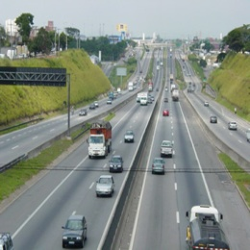
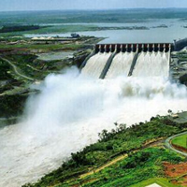
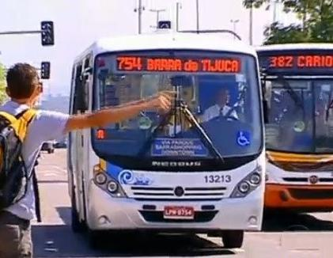

Contracting with the Government
Concession of Public Services
Concessions Law No. 8.987 / 1995: Regulates the delegation of public services by means of public biddings
  Grantee: Qualified companies or consortium of companies
  Tariffs may be reviewed in case of supervening facts which may affect the financial balance of the contract
  Concessions may be preceded by construction works
  Main types of concessions currently in force in Brazil:
    Operation of Railroads and Highways
    Generation and Distribution of Electricity
    Telecommunications
    Public Transportation

Slide 19
Contracting with the Government
Concession of Public Services
  Public Bidding Process: All concessions must be preceded by a Bidding Process
  Conditions established in a Tender Protocol:
    Description of Activity to be Delegated
    Schedule and conditions of the bidding process
    Main provisions of the Concession Contract
  Participants to provide legal , technical and financial qualification
  Criteria of Judgment:
    Lowest tariff
    Higher bid
    Lowest tariff and higher bid

Slide 20
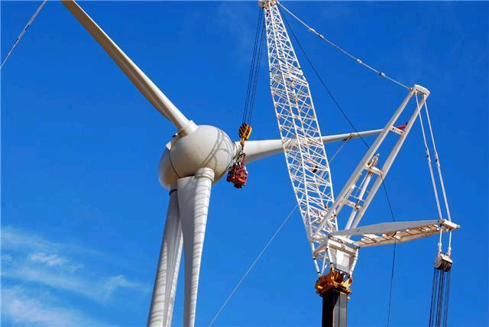
PROINFA

Slide 21
PROINFA
Program to Stimulate Alternative Resources of Electric Power
Federal program managed by MME
Law No. 10.438/2002: creation of PROINFA
Decree No. 5025/2004: regulation of PROINFA
Intends to increase the capacity of Biomass, Wind and Small Hydro Plants (PCHs) and to promote the diversity of Brazilian energy matrix.
Purchase of energy:
Eletrobrás
Public Calls (Autonomous Independent Producer can participate)
Eletrobrás will purchase the power generated by alternative sources for 20 years
Eletrobrás: state-owned company
MME: Ministry of Mines and Energy

Slide 22
PROINFA
First Phase
Implementation of a capacity of 3,300 MW
Second Phase
Until 2022, Biomass, Wind and PCHs shall correspond to 10% of the annual consume of electric energy in Brazil
Autonomous Independent Producer - 60% of plants equipment shall be produced in Brazil
Autonomous Independent Producer - 90% of plants’ equipment shall be produced in Brazil

Slide 23
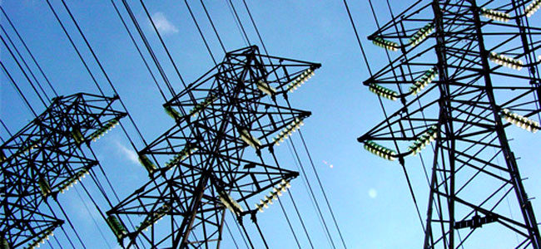
Accreditation with ANEEL

Slide 24
Small Hydro Plants (PCHs)
Company
Request to
Register the Basic Project
ANEEL
Publication of
Registry Order
Active: registry valid and effective.
Inactive: active registry that becomes ineffectual.
14 months
* Guarantee: proportional to the power of the PCH (minimum of BRL 100,000)
File the Basic Project* before ANEEL the
Publication of
Accept Order
May select the company
Economic Group Chart containing the following information:
  all shareholders’ equity participation (direct or indirect until the last level),
  minority participation higher than 5%,
  Lower than 5% if the shareholder is part of a Shareholders Agreement
Consortium Agreement
Foreign companies shall incorporate a SPC
Analysis of the Basic Project or the Project of the selected company
- Environmental license
- Hydro availability
ANEEL grants the Authorization to the PCH
File the required documents before ANEEL
30 days
Publication of Final
Accept Order of the Basic Project

Slide 25
Wind Power
Company
Request for
Authorization
ANEEL
SCG
Publication of the
Receipt Order
Company can start the construction
at its own risk
Submitted by the legal representative
Economic Group Chart containing:
  shareholders’ equity participation (direct or indirect until the last level),
  minority participation higher than 5%,
  Lower than 5% if the shareholder is part of a Shareholders Agreement
Articles of Organization
Consortium Agreement
Document evidencing the property or direct possession of the area of the project
Environmental License compatible with the phase of the project
ANEEL Analysis
Publication of the
Resolution to Authorize the Exploration

Slide 26

Power Auctions

Slide 27
Modalities of Power Auctions
MODALITIES
Auction A-1
  Existing projects.
  Held 1 year before the beginning of the supply.
  In 2013, exceptionally, may be held in the same year of the auction.
Auction A-3
  New projects.
  Held3 years before the beginning of the supply.
  Medium term enterprises, such as thermoelectric.
Auction A-5
  New projects.
  Held 5 years before the beginning of the supply.
  Long term enterprises, such as hydroelectric.
Adjustment Auction
  Held to complement the necessary energy cargo to attend the consumer market of distributors agents, until the limit of 1% of the market of each distributor.
  Structuring Projects Auction
    Strategic Generation projects of public interest.
    Long, medium and short term
  Alternative Sources Auction
    Expand the participation of alternative sources.
    Wind Power, bioelectricity
  Reserve Energy Auction
    Increase the security of electric energy supply.

Slide 28

Technical Requirements
Technical Requirements for participation in the power auctions
Project’s technical and environmental viability must be ensured to participate in the power auctions
Tender protocol of each type of power auction will clarify the requirements that must be met to prove the viability of the project.

Slide 29
Financial Requirements
Main Financial Requirements for participation in power auctions and to sign power contracts
Bid guarantees due to ANEEL:
For projects without authorization from ANEEL: of 1% of the investment value
For projects with authorization from ANEEL: US$ 1,000 per lot of energy to be offered (1 lot = 0.1 average MW)
Guarantee for faithful execution of the contract:
  The auction winners must provide 5% of the investment value declared to the Company of Energy Research. (e.g.: cash, insurance, bank guarantee, etc.)
  30 days as from the publication of the Notice of Auction Adjudication and Ratification
  The warranties will decrease in value as the construction phase of the power plant advances

Slide 30
Power Auctions
BIDDERS
  Private or Public National Companies
    By themselves
    Consortium
* Foreign companies need to constitute a SPC or enter into a Consortium
    Consortium:
  The leadership of the consortium must be a company incorporated in Brazil.
* SPC: Special Purpose Company

Slide 31
Power Auctions
WINNERS:
The lowest bid value
Winners of the new energy auctions will sign long term contracts (15 to 30 years) with distributors
INDEXATION:
IPCA (Broad Consumer Price Index)
*To be auctioned the projects needs a prior environmental licenses

Slide 32
Main results of Power Auctions
Consolidated results of new energy auctions from 2005 to 2012
Number of auctions | Projects | Capacity (MW) | Investment (US$ billion)
23 | 490 | 60,892 | 115
Source: Ministry of Finance

Slide 33
Main results of Power Auctions
December 2012 Auctions
Type | Bid Capacity (MW) | Bid Guarantees
 |  | Number of Participants | Total Amount (US$ million)
Wind Power Plant | 6,714 | 264 | 117
HPP | 988 | 5 | 82
PCH | 50 | 4 | 1
Biomass | 300 | 2 | 5
Gas | 368 | 2 | 6
Total | 8,240 | 277 | 211
Source: Ministry of Finance

Slide 34
Hydropower Expansion: Auctions from 2013 to 2017
Auction | Hydropower plant | River/State | Capacity (MW) | Total Capacity | Estimated Investments (US$ billion) - Dec/2012
2013 | SINOP | Teles Pires/MT | 400 | 1,407 | 3.1
 | Divinópolis | Paranaíba/MG-GO | 74
 | São Manoel | Teles Pires/MT-PA | 700
 | Apertados | Piquiri/PR | 136
 | Ercilândia | Piquiri/PR | 97
2014 | S. Luiz Tapajós | Tapajós/PA | 6,133 | 7,241 | 12.2
 | Água Limpa | Das mortes/MT | 380
 | Comissário | Piquiri/PR | 105
 | Foz Piquiri | Piquiri/PR | 101
 | Telêmaco Borba | Tibagi/PR | 109
 | Paranhos | Chopim/PR | 63
 | Tabajara | Ji-Paraná/RO | 350
Source: Ministry of Finance

Slide 35
Hydropower Expansion: Auctions from 2013 to 2017
Auction | Hydropower plant | River/State | Capacity (MW) | Total Capacity | Estimated Investments (US$ billion) - Dec/2012
2015 | Jatobá | Tapajós/PA | 2,336 | 3,249 | 6.2
 | Castanheira | Arinos/MT | 192
 | Itapiranga | Uruguai/SC-RS | 721
2016 | Torixoréu | Araguaia/GO-MT | 408 | 1,117 | 2.7
 | Bem Querer | Branco/RR | 709
2017 | Riacho Seco | S. Francisco/PE-BA | 276 | 8,407 | 15.8
 | Salto Augusto Baixo | Juruena/MT-AM | 1,461
 | S. Simão Alto | Juruena/MT-AM | 3,509
 | Pompeu | S. Francisco/MG | 209
 | Marabá | Tocantins/PA-MA | 2,160
 | Prainha | Aripuanã/AM | 792
Total |  |  |  | 21,421 | 40
Source: Ministry of Finance

Slide 36
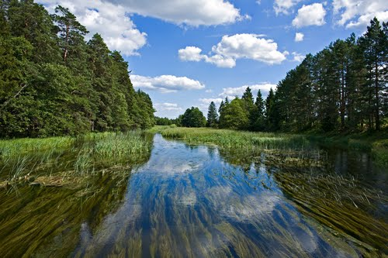
Environmental Matters

Slide 37
Environmental Licensing
Licenses are issued by the environmental authority from the State where the wind plant will be installed
Wind power plants are considered projects with low environmental impact (CONAMA Resolution 279/2001)
Simplified Licensing Procedure: 60 days for each License
Source: Environmental Ministry

Slide 38
Environmental Licensing
Licenses:
License | Documentation Required
Preliminary License | - Simplified Environmental Report, registry with ANEEL and opinion from other authorities, as applicable (also depends on State/ Municipal regulation) - Timeframe for the construction of the plant (highlighting the date of the beginning of the works), also containing the financial information for the construction of the plant.
Installation License | - Proof that has complied with the requirements for the Preliminary License - Report with Detailed Environmental Programs.
Operation License | - Evidence that all conditions informed for the application of Installation License have been duly fulfilled.

Slide 39
Simplified Environmental Report
The Simplified Environmental Report must contain the following information:
Description of the Project: Shall contain the goals and reasons for the construction of the wind power plant, evidencing that the plant is compatible with public policies and governmental programs and plans. The description shall also evidence alternatives to the technologies used and the place where the plant will be installed, taking in to consideration to possibility of not concluding the project.
Environmental Diagnosis and Prognosis: Description of the potential environmental and economic impacts for the installation and operation of the plant. Description of the environmental quality for the area where the plant will be installed, considering different environmental issues.
Compensatory and Corrective Measure: Identification of impacts that cannot be avoid. Recommendation regarding the most favorable alternative and support and monitoring program

Slide 40

Taxes Incentives

Slide 41
Taxes Incentives
Taxes:
Tax | Incidence | Rate
ICMS | State, value-added tax levied on the import of products and certain transitions involving goods, intermunicipal and interstate transportation services and communication services | 7-30%
IPI | Federal tax levied on the import and manufacturing of goods | Depends on the product classification
PIS and COFINS | Federal taxes, charged on Revenues ,on monthly basis. | PIS :0.65 - 1.65 % COFINS: 3 - 7.6%
CIDE | Contribution levied on import and sale of oil and gas products, including ethanol | 0- BRL 230 by cubic meter

Slide 42

Taxes Incentives
Special Regime of Taxation
2009: House of Representatives approved a Bill of Law creating a Special Regime of Taxation to encourage the development and production of electric power from alternative resources.
Tax benefits such as exemptions of PIS and COFINS and IPI for companies operating under the Regime
Status: Waiting to be approved by the Federal Senate
*Biodiesel: Producers and importers of have a special tax regime
*Ethanol: sales and distributors have some tax advantages

Slide 43
Thank you.

