Slide 1

Brazil 2016
Political Overview
Lucas de Aragão // Arko Advice

Slide 2
Impeachment Timeline
The Next Steps of the Process
Special Committee
65 members to be decided according to proportional party representation. Should be concluded early March.
Voting on the House Floor
If 2/3, or 342 Congressmen, vote for her impeachment, process reaches the Senate. Should be concluded end of March
Notes:
Comissao: 10 dias parecer favorável ou não. 20 dias defesa Dilma.

Slide 3
First Senate Vote
A simply majority vote decides if impeachment process should be opened. If approved, Dilma is temporarily removed from power. This stage should take 45 days.
Second Senate Vote
Last vote. If 2/3, or 54 Senators, decide in favor of the impeachment, Dilma is no longer the President of Brazil. This stage should also take 45 days.
Notes:
Maioria simples: metade mais um de no minimo 41.

Slide 4
Loyalty of Dilma’s allied base
75%
63%
57%
53%
54%
45%
40%
PP
PTB
PMDB
PSD
PR
PRB
PT

Slide 5
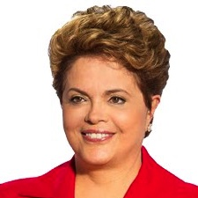
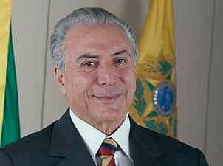
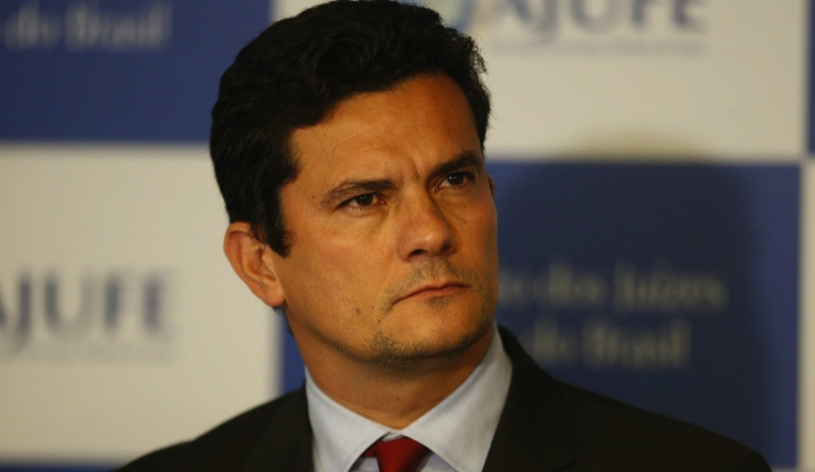
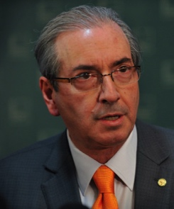
1.
Irresponsible fiscal policy – tax manuevers - in the first mandate. In the second, lack of support to Minister Levy and submission of budget with a deficit.
Poor conduction of politics in the first term, disregarding dialogue with Congress and VP Michel Temer.
2.
Concentrated power in the PT. Governing coalition without decision-making power. Inner-circle unfit for the job.
4.
3.
PMDB:
Poor conduct in the election of Eduardo Cunha;
Alliance with PSD;
Isolation of Michel Temer
5.
Car-Wash Operation
Continued adoption of measures that were contrary to the campaign speech, such as increase in interest rates, social welfare cuts. Consequent withdrawal from social movements and the PT.
Lack of political intelligence, which led to unfulfilled agreements, sabotage, friendly fire, urgent decisions postponed, etc.
6.
7.

Slide 6
The PT / PMDB Relationship
Key Milestones if Dilma survives
Party Leader
Party Convention
Lava-Jato
Heavyweights

Slide 7
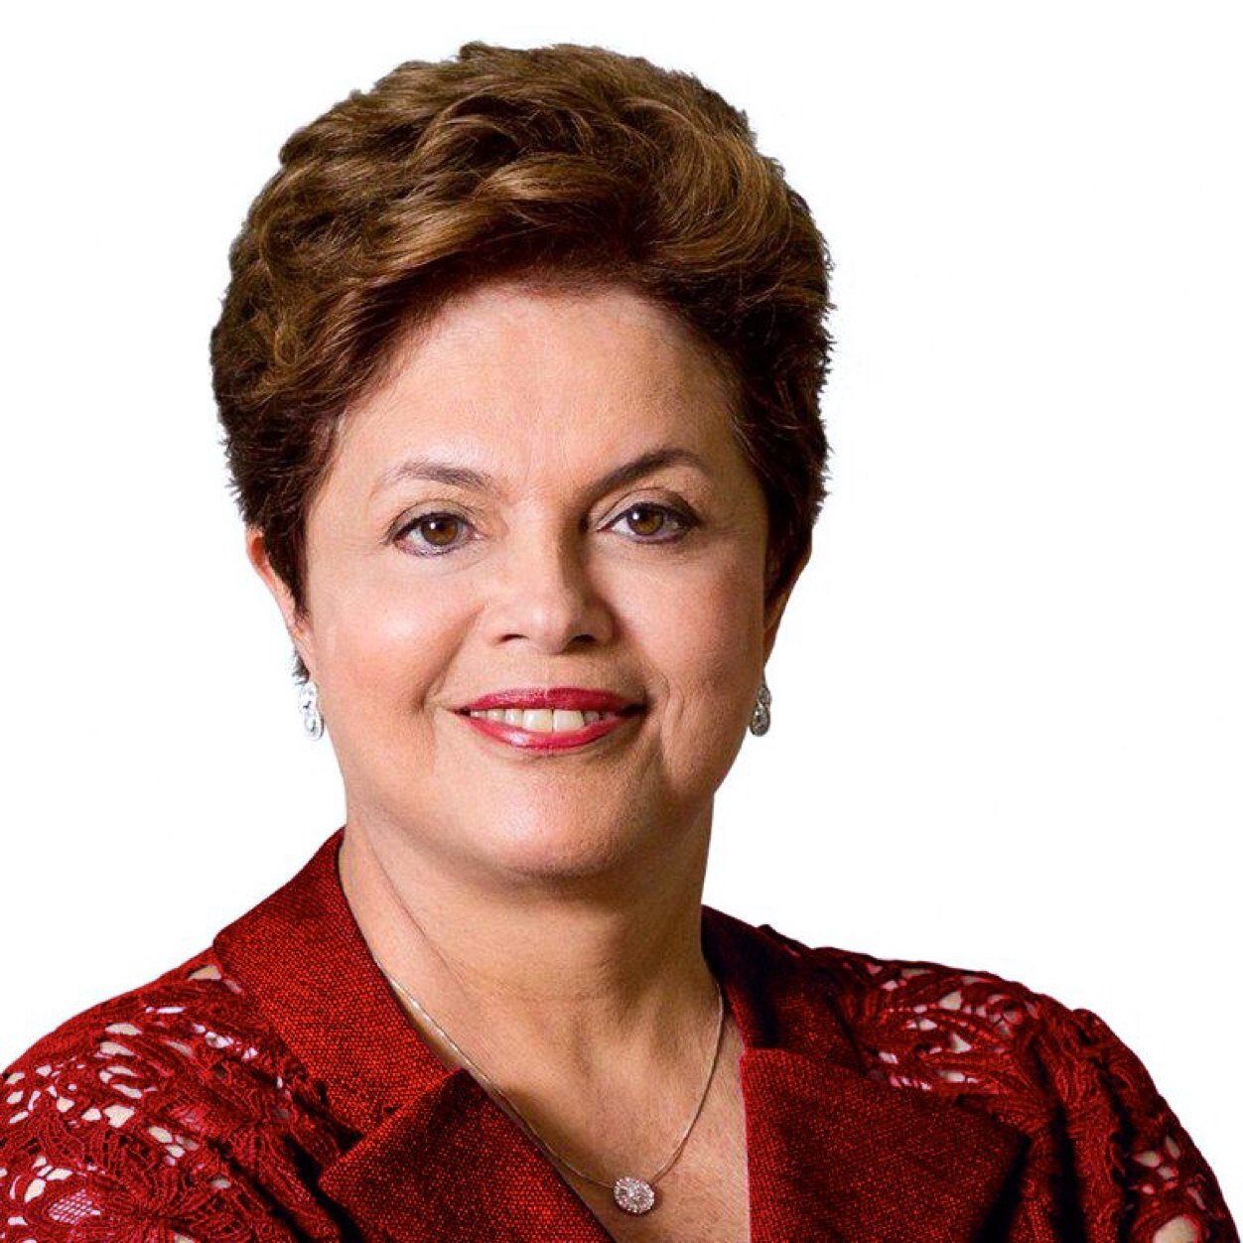
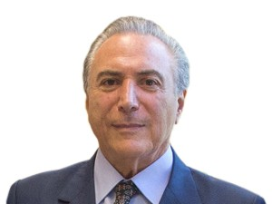
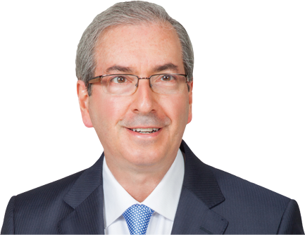
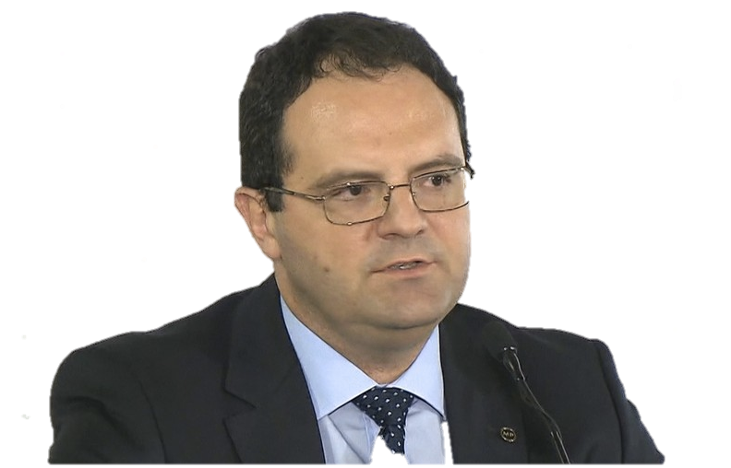
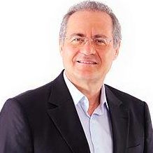
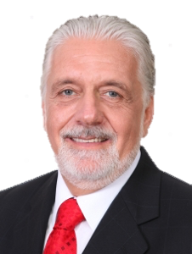
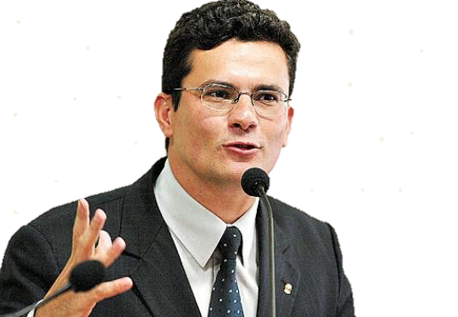
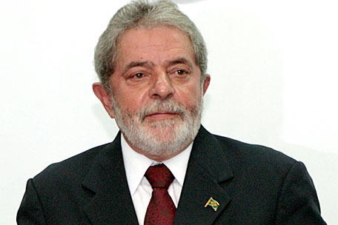
Key Actors

Slide 8




Institutions
State under the spotlight
STF
Holds the key for the impeachment and Lava-Jato proceedings.
TSE
Decisive in the ruling of the Dilma-Temer ticket.
Federal Police
Ongoing Lava-Jato operation directly impacts political and economic world.
Congress
Gatekeepers of the impeachment and battlefield of public policies.

Slide 9
Civil Society
What matters for the average voter
Corruption
Health
Education
Unemployment
Source: Datafolha Poll

Slide 10





What to expect in 2016
Impeachment
Proceedings
Cunha’s Future
Economic Measures
Municipal Elections
Lava-Jato
56

