Slide 1
Talent Management & Succession planning – Latam and Europe in uncertain waters
Presented to: Brazil-UK Chamber of Commerce
Date: May 22nd, 2018

Slide 2
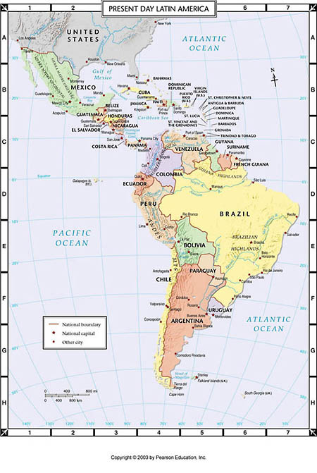
Latin America
Diverse region. Centered around a few countries from a global business point of view.
Hubs: Brazil, Argentina and Mexico. Miami/US also considered. Chile and Colombia recognized for its stability and robust talent base and Panama is attracting foreign investment.
Due to education and safety, talents may want to move away from the region, but family ties may keep them there.
Notes:
Option 3 for a slide on our understanding of their situation

Slide 3
Latam – issues: talent attraction
Experienced Executives in high demand
All Countries experiencing boom in hiring. Pre-elections?
Misalignment in salary expectations
Digital understanding becoming mandatory for any executive function
Jobs are changing towards data analytics
Specialized Sales professionals
Make the number -- continues to be the name of the game
Notes:
Option 3 for a slide on our understanding of their situation

Slide 4
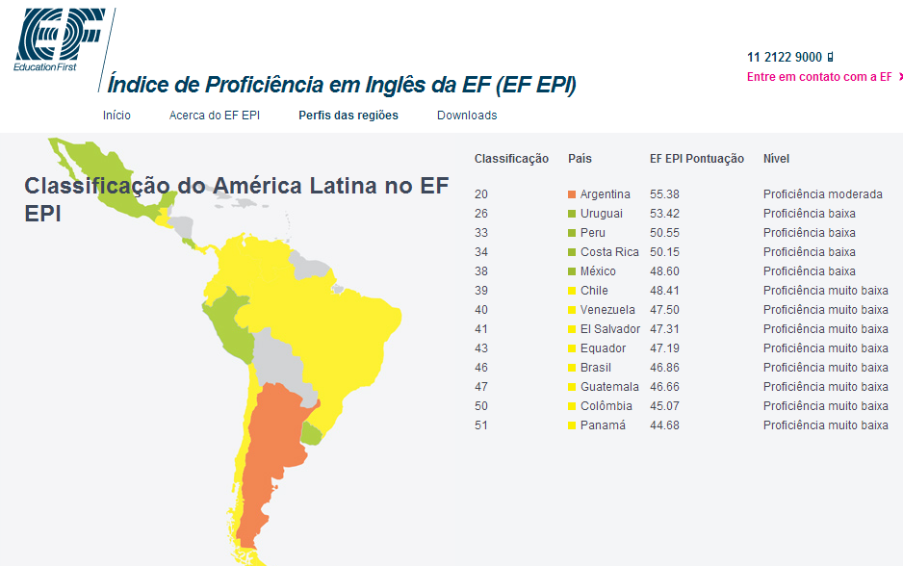
Latam – issues: talent attraction
4. Lack of language skills – Orange: Moderate Proficiency, Green: Low, Yellow: Very Low
Notes:
Option 3 for a slide on our understanding of their situation

Slide 5
Latam – issues: talent attraction
What to do/how to be relevant:
#1: Brand
Big brands are easier to attract? – that cannot be totally true. Candidates willing to understand the purpose behind the brand.
What is social media saying about this Brand/Co. More companies are mining social media and employer review sites like Glassdoor after laying off an employee.
Small companies highly attractive if they have differentiators.
#2: Opportunity: career upwards
Today companies are lean, structures have individual contributors, and it is a challenge that employees understand the value of lateral moves.
With upward in career comes a bigger salary? Not always.
Notes:
Option 3 for a slide on our understanding of their situation

Slide 6
Latam – issues: talent retention
#1: Train the leadership team. Executives leave their bosses, not the company.
Misalignment perceptions about the company’s most important attributes to retain top talent x what employee see as important.
Employee satisfaction survey / Best Place to Work
Poor cultural fit is the most important reason for staff turnover (not brand or reputation)
Salary expectation x rising inflation
Family business:
Prepare a successor: specially when the owner does not want to leave the seat.
The direct reports to the owner are always the most vulnerable to the company
Notes:
Option 3 for a slide on our understanding of their situation

Slide 7
Latam – How to win the war for talent in latin america
Train the leaders on how to identify and develop talent from within.
Train the high potentials. They will not leave while they continue to learn.
Evaluation reviews with metrics and personalized career paths.
Ask where they would like to go. Promotion is not always the best solution.
Create a cooperative culture. Install a 360o degree evaluation, employee feedback, and get their knowledge of the culture they have and the one they want.
Notes:
Option 3 for a slide on our understanding of their situation

Slide 8
Latam – How to win the war for talent in latin america
There is a thirst for knowledge and education across Latin America, a real desire to be at the table and to be heard, specially from executives of multinational companies.
-- the majority of the C-Level executives in LatAm have at least one Post Graduation or MBA.
If political, social and economic stability align, this will enable a platform for talent to develop, and the LatAm region will become a very powerful global player in the game.
Notes:
Option 3 for a slide on our understanding of their situation

Slide 9
THANK YOU.
Magui Castro
mcastro@caldwellpartners.com
+44 7464.420110

Slide 10
Talent Management & Succession planning –Europe in uncertain waters

Slide 11
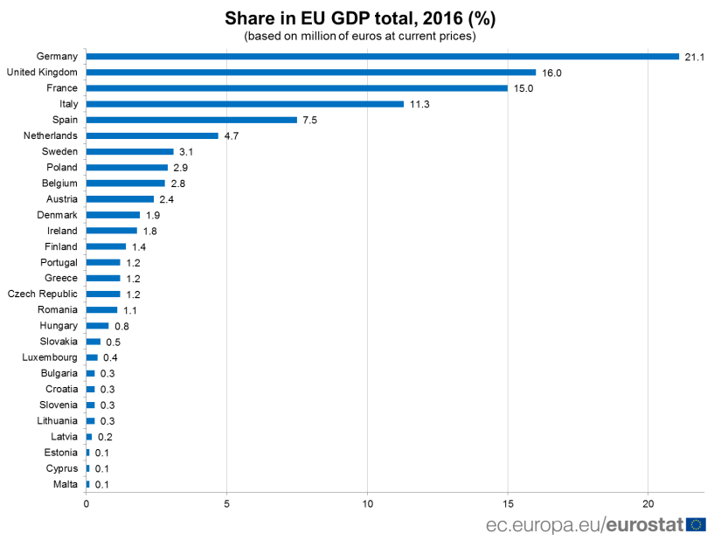
Uncertain waters in Europe
The European Union has undergone a great deal of change over the past few years, including general elections in France, Germany, the UK and Italy. However the biggest shake up has been Brexit.
European economies by scale (EU GDP %)
The UK is the 2nd largest economy in the EU behind Germany
2016 vote
Leave 51.9%
Remain 48.1%
71.8% turnout = @30mm voters
England & Wales voted to LEAVE
Scotland & N. Ireland voted to REMAIN
Follow on DATES
29th March 2019 – transition period begins
31st December 2020 – transition ends
During the transition period free movement continues. UK can agree new trade deals but won’t come into force until 1 Jan 2021
Notes:
Option 1 for a slide on our understanding of their situation

Slide 12
Immediate Concerns
A recent CIPD survey stated that:
Post Brexit trends
Tougher competition for talent:
Cautiousness of candidates to move jobs during uncertain times
Border issues in the future (for EU nationals)
Loss of jobs to the EU via corporate relocations
Post Brexit vote just over 1 in 10 private sector firms were considering relocation of some or all of their business operations. Top locations were:
24% move outside EU
18% Ireland
15% Germany
13% France
Notes:
Option 3 for a slide on our understanding of their situation

Slide 13
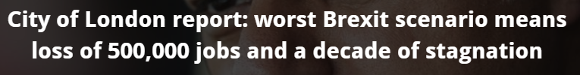
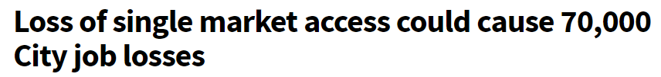
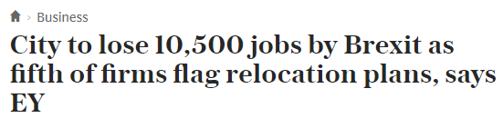
Market Climate
Movement of Jobs to the EU – Perceived Reports
New Europe
(January 2018)
Investment Week (July 2017)
The Telegraph (December 2017)
Notes:
Option 3 for a slide on our understanding of their situation

Slide 14
Market Climate Movement of Jobs to the EU – Actual Plans
Estimated number of
actual departures
Previously announced number of
actual departures
JPMorgan
700 jobs moving
CEO Jamie Dimon warned of up to 4,000 London job losses ahead of the Brexit vote
10,480
Staff
Deutsche Bank
350
Deutsche Bank previously said 4,000 jobs could move in a worst case scenario
7,000
Barclays CIB
150
‘If you look at the reactions to Brexit…most of the US banks have talked about a far greater impact in …London operations than we have’ Jes Staley, CEO, Oct 2017
6,500
Citi Group
250
6,000
Goldman Sachs
500
‘We will have more staff on the continent (in) Frankfurt and Paris…Brexit is forcing us to decentralize our activities’ Lloyd Blankfein, CEO, Oct 2017
5,959
Morgan Stanley
100
5,000
UBS
200
‘1000 (job) moves…is becoming, in the last few months, more and more unlikely’
Sergio Ermotti, CEO Oct 2017
5,000
Credit Suisse
250
5,000
Source: Financial Times, December 2017

Slide 15
The challenging environment
This level of uncertainty has lead to:
75% of organisations had experienced recruitment difficulties in the past year and 10% had trouble recruiting for more than 50% of the roles they needed to fill;
Increasing levels of competition at all levels for well-qualified talent;
Skills needed for those jobs are changing and evolving;
Add in the uncertainty of Brexit and it has a knock on effect of both candidates and corporations being increasingly cautious about recruitment:
Is it the right time to make the hire/geographic expansion?
For C-suite candidates, do they want to take the risk of moving – with family in some cases and to a new country?
Notes:
Option 3 for a slide on our understanding of their situation

Slide 16
The challenging environment
However this level of uncertainty has also lead to a number positives:
The drop in the value of the £ has seen a greater increase in the amount of foreign investment in the country;
The amount of capital raised for alternative investment strategies (private equity, infrastructure more specifically) has increased dramatically, creating more opportunity;
The regulatory regime in the UK has continued to be seen globally as one of the most stringent and commercial, giving further confidence of inbound investment;
Notes:
Option 3 for a slide on our understanding of their situation

Slide 17
Attracting and maintaining talent
Given these factors, organisations across the UK and EU are stepping up:
Renewed focus on employer brand
Greater awareness of social media; and campaigns targeting specific talent pools;
The corporate website is the first point of contact with the organisation;
Developing more talent in-house
Greater focus on building better 360 degree assessment plans and linking these to development and succession plans;
Greater listening and feedback via employee engagement surveys and follow up communication;
Succession planning is essential, as is the communication of this internally;
Further focus on diversity
Broadening the diversity of thought;
Measuring effectiveness and return on investment through better training and development.
X
X
X
X
X
x
Notes:
Option 3 for a slide on our understanding of their situation

Slide 18
Talent Considerations
From a candidate perspective, the factors are changing as well:
Increased reluctance to take risk
There is debate whether now is the time to move from a strong brand into an early stage start up, or even to move at all;
Conversely, the interest in private equity and/or portfolio company has never been higher;
Compensation views
Candidates are looking to gain a greater balance of cash compensation and equity in the business;
Notes:
Option 3 for a slide on our understanding of their situation

Slide 19
Talent Considerations
From a candidate perspective, the factors are changing as well:
Lifestyle
The focus on work/life balance has come to the fore, with social networking companies and increased technology businesses offering different work styles;
Diversity
The greater the need and desire for diversity of individual and thought is respected and welcomed;
BUT, this process needs to be long term and carefully considered.
Notes:
Option 3 for a slide on our understanding of their situation

Slide 20
Questions?
Notes:
Option 3 for a slide on our understanding of their situation

Slide 21
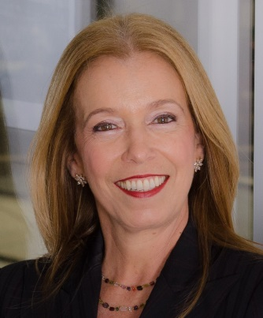
Bio - Magui Castro
Magui Castro is a partner in the London and Latin America’s offices and a member of the Consumer, Retail & E-Commerce as well as the Healthcare Practices, specializing in recruiting C-level executives and Board Members.
She has a reputation for successfully working with global and local clients, bringing to them personal attention and being a trusted advisor to many of Brazil’s leading business executives.
With more than 10 years at the Executive Search industry, before joining Caldwell Partners, Magui was a partner at CTPartners for the Retail, Consumer and Life Sciences Practices. She joined the Executive Search industry in 2007, at Southmark, after being a distinguished corporate executive for 15 years.
Magui gained broad management experience while holding marketing roles with global multinationals. Among these are AMBEV, Gillette, Coca-Cola and Kodak. Relocating from Brazil to Chile, Magui became a regional CEO of Kodak. Later she served as Chief Executive Officer of Viña Estampa, a first class boutique winery in Chile.
Her past experience as CEO enabled her to specialize in assignments for CEO positions and its direct reports.
Magui’s educational attainments include the Smith College’s Senior Executive Program in Northampton, MA, USA, and holding two post-graduate degrees – Marketing and Finance – from the PUC in Rio de Janeiro. She graduated in Literature. While in Chile, Magui was a director of AMCHAM and a member of the International Professional Women Association. Fluent in English and Spanish, and native Portuguese, Magui is based in the firm’s London office, UK.
direct +44 (0) 20 3167 2508
mobile +44 (0)7464 420 110
mcastro@caldwellpartners.com
London
12th Floor, CityPoint,
1 Ropemaker St. London, London EC2Y 9HT
Notes:
Option 3 for a slide on our understanding of their situation

Slide 22
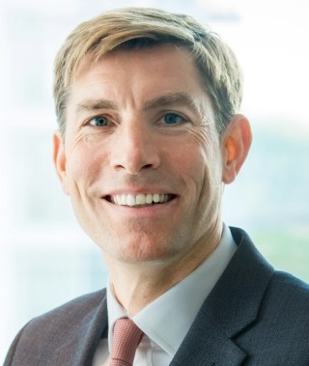
Bio – Alex Alcott
Alex Alcott is a partner in Caldwell’s Financial Services Practice, and a managing partner of the London office. With more 20 years of executive search experience, Alex works across a range of clients including global investment banks, hedge funds, private equity firms and portfolio companies, diversified consumer financial services firms, insurance companies, and asset and wealth management firms. He has worked on a variety of CFO, general auditor, controller, treasurer, head of tax and other finance function searches both as one-off senior roles, as well as consultative ‘team builds’ for newly-merged or growing organizations or private equity portfolio company rebuilds.
Alex also works on senior-level assignments in infrastructure and private equity funds, and has completed many senior infrastructure and real estate assignments for clients across the global financial services industry. His clients include a variety of domestic and foreign banks, funds, infrastructure, insurance companies, real estate and private equity firms in Europe, the United States and Asia.
Alex was most recently a partner at Heidrick & Struggles’ London office (having previously worked in the firm’s Wall Street office), where he was a member of the global Financial Services and Chief Financial Officers practices and led the Financial Services CFO practice in the UK. Prior to joining Heidrick & Struggles, Alex spent six years with a boutique executive search firm based in London and New York.
He holds a Bachelor of Science in biology from the University of Bristol, UK.
direct +44 (0) 20 3167 2505
mobile +44 (0) 7507 269 510
aalcott@caldwellpartners.com
London
12th Floor, CityPoint,
1 Ropemaker St. London EC2Y 9HT
Notes:
Option 3 for a slide on our understanding of their situation

Slide 23



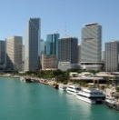
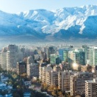




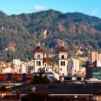







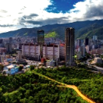




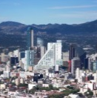
OFFICES AROUND THE WORLD
ATLANTA
CHARLESTON
MIAMI
SANTIAGO
AUCKLAND
DALLAS
NASHVILLE
SAO PAULO
BOGOTA
LIMA
NEW YORK
STAMFORD
BUENOS AIRES
LONDON
PHILADELPHIA
TORONTO
CARACAS
LOS ANGELES
SAN FRANCISCO
VANCOUVER
CALGARY
MEXICO CITY

Slide 24
THANK YOU.
Magui Castro and Alex Alcott

