Slide 1


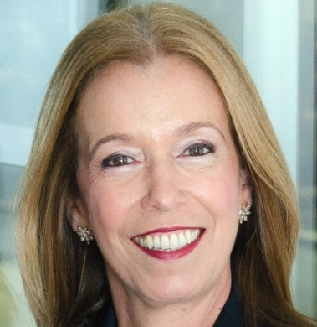
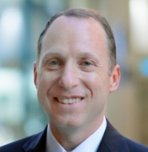
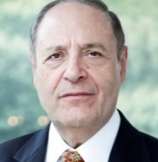

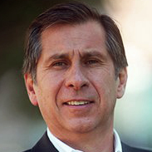

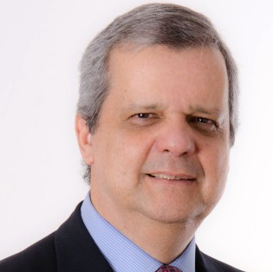
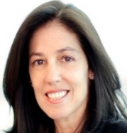
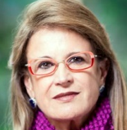

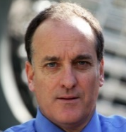
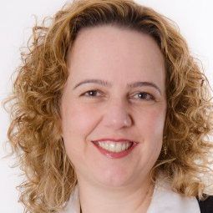
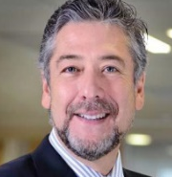
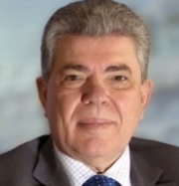

Latin America
Atlanta – Bogota – Buenos Aires – Caracas – Dallas – Lima – London – Los Angeles – Mexico City – Nashville – New York – Philadelphia
San Francisco – Stamford – Santiago – São Paulo – Toronto – Vancouver
www.caldwellpartners.com

Slide 2

How to Build a Succesfull Career
Do’s and Don’ts
Magui Castro – Partner - London & Brazil
mcastro@caldwellpartners.com

Slide 3
My Career
Fleishchmann & Royal: Assistant Brand Manager
Ambev: Jr Brand Manager - Beer Brahma Chopp (#1)
Gillette (P&G): Brand Manager/senior Paper Mate & Waterman
Coca-Cola: Marketing Manager of Coca-Cola brand/ Marketing Director
Kodak: Marketing Director/President to Chile, Bolivia and Paraguai
Viña Estampa: President
Southmark/CTPartners/Caldwell Partners: Managing Partner & London Partner

Slide 4

There is more to Life than Being Happy
About the speaker
Emily Esfahani Smith · Journalist, author
Of the book "The Power of Meaning,"
Our culture is obsessed with happiness, but what if there's a more fulfilling path? Happiness comes and goes, says writer Emily Esfahani Smith, but having meaning in life -- serving something beyond yourself and developing the best within you -- gives you something to hold onto.
This talk was presented at an official TED conference.
Show film … https://www.ted.com/talks/emily_esfahani_smith_there_s_more_to_life_than_being_happy

Slide 5
There is more to Life than Being Happy
Excerpts from the video
I used to think the whole purpose of life was pursuing happiness. Everyone said the path to happiness was success, so I searched for that ideal job, that perfect boyfriend, that beautiful apartment. But instead of ever feeling fulfilled, I felt anxious and adrift. And I wasn't alone; my friends -- they struggled with this, too.
Studies show that people who have meaning in life, they're more resilient, they do better in school and at work, and they even live longer.

Slide 6
There is more to Life than Being Happy
Excerpts from the video
To find out, I spent five years interviewing hundreds of people and reading through thousands of pages of psychology, neuroscience and philosophy. Bringing it all together, I found that there are what I call four pillars of a meaningful life. And we can each create lives of meaning by building some or all of these pillars in our lives.
The 1st pillar is belonging. Belonging comes from being in relationships where you're valued for who you are intrinsically and where you value others as well.
  Valued by your family, friends, partners at work. If you don’t feel you belong, you have to do something about it.
  “You can choose to cultivate belonging with others”.

Slide 7
There is more to Life than Being Happy
Excerpts from the video
For many people, belonging is the most essential source of meaning, those bonds to family and friends. For others, the key to meaning is the 2nd pillar: purpose. Now, finding your purpose is not the same thing as finding that job that makes you happy. Purpose is less about what you want than about what you give.
The key to purpose is using your strengths to serve others. Of course, for many of us, that happens through work. That's how we contribute and feel needed.
  Disengagement at work, unemployment, low labor force participation -- these aren't just economic problems, they're existential ones, too. Without something worthwhile to do, people flounder.

Slide 8
There is more to Life than Being Happy
Excerpts from the video
The 3rd pillar of meaning is also about stepping beyond yourself, but in a completely different way: transcendence. Transcendent states are those rare moments when you're lifted above the hustle and bustle of daily life, your sense of self fades away, and you feel connected to a higher reality.
For one person I talked to, transcendence came from seeing art. For another person, it was at church. For me, I'm a writer, and it happens through writing.
  Meditation? Singing?

Slide 9
There is more to Life than Being Happy
Excerpts from the video
Belonging, purpose, transcendence. Now, the 4th pillar of meaning, I've found, tends to surprise people. The fourth pillar is storytelling, the story you tell yourself about yourself.
Creating a narrative from the events of your life brings clarity. It helps you understand how you became you.
But we don't always realize that we're the authors of our stories and can change the way we're telling them. Your life isn't just a list of events. You can edit, interpret and retell your story, even as you're constrained by the facts.
  Coaching for interviews

Slide 10

There is more to Life than Being Happy
Excerpts from the video
That's the power of meaning. Happiness comes and goes. But when life is really good and when things are really bad, having meaning gives you something to hold on to.

Slide 11

Career
Do’s
Do whatever is needed (not only your job description);
Be ethical;
Be generous, help your peers whenever you can;
Keep on studying, learning;
Believe in yourself, in your potential. Always do your best;

Slide 12
Career
Do’s
Deeply understand your business. Go prepared to your meetings;
When you see a vacant position in your company that fits your profile, don’t hesitate: ask to be there. You deserve to be there. Be confident on that.
  A PWC survey (3600 prof. women – age 28-40 in 60 countries) showed that only 17% put themselves for roles they are 100% qualified.

Slide 13
Career
Do’s
Be your Marketing Director: promote yourself, by telling people what you have achieved. Men do it and women should learn to do it as well.
  “Great work should speak for itself”, but it does not.
Create your elevator speech that explains how you view your career path.
  It can help you think more clearly about your future. It can also make you feel more confident, prepared.

Slide 14

Career
Don’ts
To say: “this is not in my job description”;
Try to be perfect, master every detail of your job -- can be a trap to keep you in your current role;
  It can be shocking, but it is true. You need time to build relationships, connections and visibility to get to the next level.

Slide 15
Career
Don’ts
Be Perfect;
  The perfection trap: the belief that I will succeed if I do my job perfectly well, often give women a hard time, getting them tangled up in self-blame, instead of moving on.
  Yes, you can make mistakes. Risk taking requires being opened to failure.
  Yes, you can delegate.

Slide 16
Career
Don’ts
Wait until you know all the aspects of the next position to ask for it;
Be reluctant to claim your achievements
  Don’t say: I couldn’t have done without my colleague (if you did 90% of the work). Instead say: “Thank you, I worked hard on this”.

Slide 17

Profiles Headhunters Always Look For:
Generous: knows how to teach and help;
Ethical;
Owner attitude, vibrant!
Self-motivated;
Not only a inspiring leader, but also a leader that serves as a model;

Slide 18
Profiles Headhunters Always Look For:
Understands that needs to do more with less;
May not come from same industry, but needs to learn fast;
Bring ideas, participate in the meetings, make a difference;
“Put on the company’s T-Shirt”;
Knows how to listen and even change opinions if the other makes more sense.

Slide 19

Profiles Headhunters Do Not Want:
Screaming or bullying type of executive, bad humoured, pessimist (sees the glass half empty)

Slide 20
Thank you! / Obrigada!
Questions?
mcastro@caldwellpartners.com
+44 020 3167.2508

