Slide 1










Addressing Financial Wellbeing at the workplace
Délber Lage, SalaryFits CEO

Slide 2






Based on a research made by the CIPD, around 2/3 of UK employees currently experience money worries.

Slide 3






1 in 4 workers report that money worries have affected
their ability to do their job
(CIPD 2017)

Slide 4





FINANCIAL WELLNESS
‘There is a growing recognition that wellness is holistic and co-dependent; physical, emotional and financial health work together, and if one part is missing, this imbalance may also impact the other two.’ (CIPD, 2017)
Financial health has traditionally been seen as a standalone provision;
Growing recognition that wellness is holistic and co-dependent; physical, emotional and financial health work together;
And while financial well-being exists at a personal level, a lack of it can also have a big impact on the workplace and society as a whole, with a loss of productivity and effectiveness.
Crucial role of employers.

Slide 5
FINANCIAL WELLNESS
Financial environment
Company
Individual financial wellbeing
Government provisions
(such as social security)
State of the economy
Salary & Benefits
Financial Training
Access to sustainable products via payroll access (data access + repayment)

Slide 6



EMPLOYEES’ SATISFACTION
Employers cannot afford to neglect the effects that financial worries can cause on their employees and their workforce.
Our belief is that all employees deserve to feel financially secure and supported. With SalaryFits you can assist your employees in their financial needs.
80%
38%
33%
Neyber and Barclays surveys
of British workers would move to an employer where financial wellbeing would be considered a priority
reported that financial worries were among their biggest concerns.
are not happy with the efforts being taken by their employers to support their finances.

Slide 7





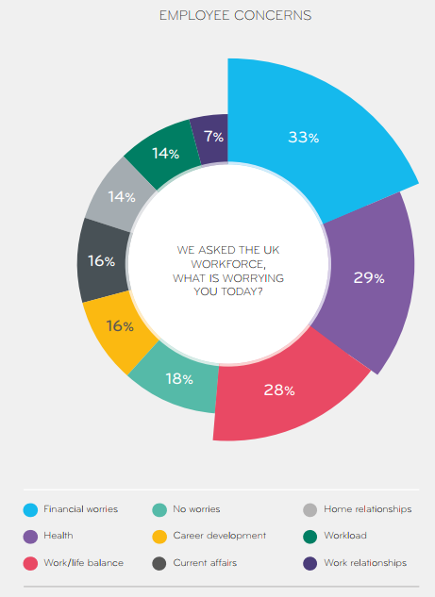

EMPLOYEE CONCERNS
58% of employees are facing difficulties in managing their finances, 19% losing sleep and 8% spending working hours to deal with money problems (CIPD 2017).
40% declared that financial worries caused them stress (Evans 2016).
FINANCIAL IMPACT FOR EMPLOYERS
On average an employee spend 20 working hours per month dealing with personal finance matters, and that this can cost a company around $5,000/year/employee (Federal Reserve).
Lost productivity due to money worries impacts a company’s bottom line by 4% (Barclays).
(Neyber)

Slide 8





CHALLENGE FOR EMPLOYERS
We cannot neglect the adverse impact caused by financial distressed employees on the company’s bottom line. It is clear that distracted and anxious workers directly reflect their personal situation on businesses’ results.
Worse
Work
Performance
Higher
Turnover
Higher
Absenteeism
Higher
Healthcare
Costs
Pilferage

Slide 9

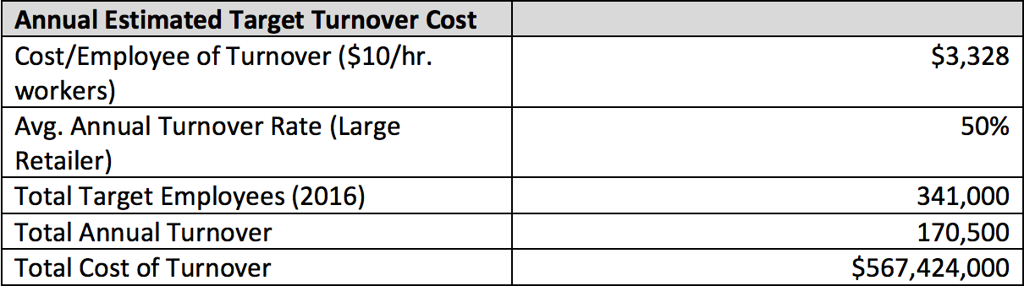
BUSINESS CASE
A recent research estimated the following turnover expenses for lower income employees:
16% of annual salary for high-turnover, low-paying jobs (earning under $30,000 a year).
20% of annual salary for midrange positions (earning $30,000 to $50,000 a year). E.g. the cost to replace a $40k retail manager would be $8,000.
Target’s annual cost of turnover appears to be at least $567 million, or about 4% of Target’s 2017 selling, general and administrative expenses
(Heather Boushay and Sarah Jane Glyn of The Center for American Progress)
Notes:
Similarly, large relative cost numbers would also apply to most retailers, hospitals, hotels and other employers.

Slide 10
FINANCIAL EDUCATION
We believe that employers should offer more than access to fair financial products. By working closely with our partners and clients, we are keen on enhancing the understanding of their employees financial needs.
Credit
Consolidation
guidance
Goal Setting
Improve
Financial
Habits
Psychological/ Behavioral Finance
Financial
Planning

Slide 11

IS IT ABOUT PUSHING FINANCIAL PRODUCTS OR ENCOURAGING DEBT?
In the UK, over half of our existing customers turn to SalaryFits for debt consolidation and are benefiting from a 20% reduction in monthly debt repayments; equivalent to a 5% increase in salary. We focus on affordability meaning staff don't take on more than they can reasonably afford.
SUSTAINABLE CREDIT HELP AN VERAGE BRITISH EMPLOYEE TO SAVE MORE THAN
£1518 ON DEBT REPAYMENTS
Payroll Loan
Credit Card/Overdraft
Payday Loan*
Average British has a £4,900 loan to pay back in 5 years.
APR:
7.9% year
mount payable:
$5947
APR:
18% year
Amount payable:
£7466
APR:
+800% year
Amount payable:
At least 20x more
Notes:
It is not about pushing products or encouraging debt, for example. The solution relies on offering sustainable solutions, better products and a way-off to financial distress.
Example of a british employee in our platform
Points to mention:
Almost the same APR offered across all employees (especially important for the ones without access to consumer loans)
Payday loan is a extreme example if the customer cannot repay its loan in the first month and keep pushing the debt forward

Slide 12




www.salaryfits.com
Délber Lage
CEO
delber.lage@salaryfits.com
+44 (0) 7414 027 493

Slide 13







PLATFORM
SalaryFits’ platform allows services providers to integrate their systems with payroll information of entities, providing access to a new risk assessment tool, as well as the possibility of the deducting the installments directly from one’s salary.
It is an innovative solution to make sustainable financial products a reality and empower individuals through their salaries.
Seamless integration
(Already integrated with +150
companies’ payrolls systems)
Automated and transparent
processes
100% cloud-based
ISO 27001 & 9001 compliant

Slide 14











FLEXIBLE TECHNOLOGY
That can integrate a diverse portfolio of financial and non-financial products.
Health
Care
Insurance
Pensions
Loans
and more!

Slide 15
AN ADVANTAGE FOR EMPLOYERS
For the employers, our technology is a unique opportunity to enhance employee’s ﬁnancial wellbeing, access to fair products as well as their productivity.
Support
employees’ financial
needs
Improve workforce
productivity and
engagement
Cost-free
solution
Better work
Environment and
Retention rates
No
liabilities
Hassle-free
benefits

Slide 16

GREAT BENEFIT FOR EMPLOYEES
Employees can have access to cost-effective ﬁnancial products with lower interest rates and less bureaucracy, as well as a better management of their ﬁnancial health.
Broader range
of products
offered
Credit
consolidation
Lower
interest
rates
Better
financial
habits
Access
to fair financial products
Lower
bureaucracy

Slide 17




AND AN OPPORTUNITY FOR FINANCIAL INSTITUTIONS
For Financial Institutions, we provide an easy and convenient commercial channel to reach a large amount of potential clients, with lower costs of acquisition and with more reliability.
Lower
default rates
Security and
anti-fraud
control
More
Information and
Convenience
Lower
transaction
costs
Lower
acquisition
costs
Target existent
customers and
new entrants

Slide 18





EXPERIENCE
THE BRAZILIAN
CASE
4.5M
SalaryFits is the international spin off of Zetra, a mature company that significantly improved the Financial Benefits market in Brazil, bringing financial inclusion to over 3 million individuals.
This platform is used by 52 of the country's financial institutions – including the 5 largest banks.
3.5M
DEDUCTIONS/MONTH
ONLINE USERS
17B
DOLLARS IN
OPERATIONAL CONTROL

Slide 19

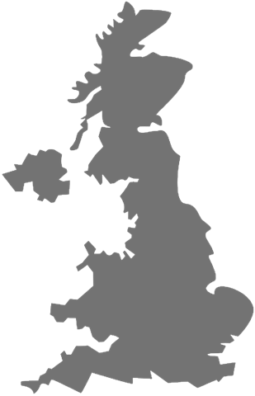



EXPERIENCE
FIRST MONTH IN THE
UNITED KINGDOM
Just onboarded of one of the largest British employers (+130K employees) in Mar-18.
Through the closed partnership with a challenger bank, leading provider of salary deductible loans, SF expects to:
Initiate full roll out from June. On-board +300K employees in 2018, including 2 major retailers already in the pipeline;
Integrate savings until the end of 2018.
257K
DOLLARS
PROCESSED/MONTH
150K
EMPLOYEES
ONBOARD
1.8M
DOLLARS IN
OPERATIONAL CONTROL

Slide 20
















MORE THAN 16 YEARS OF KNOWLEDGE AND EXPERTISE!
Patented Platform
Business Intelligence
Security Management
Certification
Information Security
Management System
ITIL and ISO (27001 and 9001)
Certifications

Slide 21


INTERNATIONAL PRESENCE

Slide 22




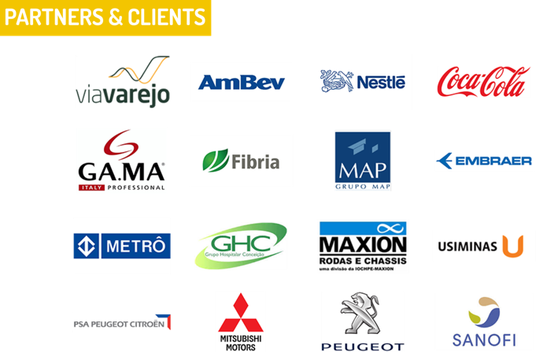




PARTNERS & CLIENTS

Slide 23
www.salaryfits.com
Délber Lage
CEO
delber.lage@salaryfits.com
+44 (0) 7414 027 493

